Slide 2
Lesson 1

Slide 3
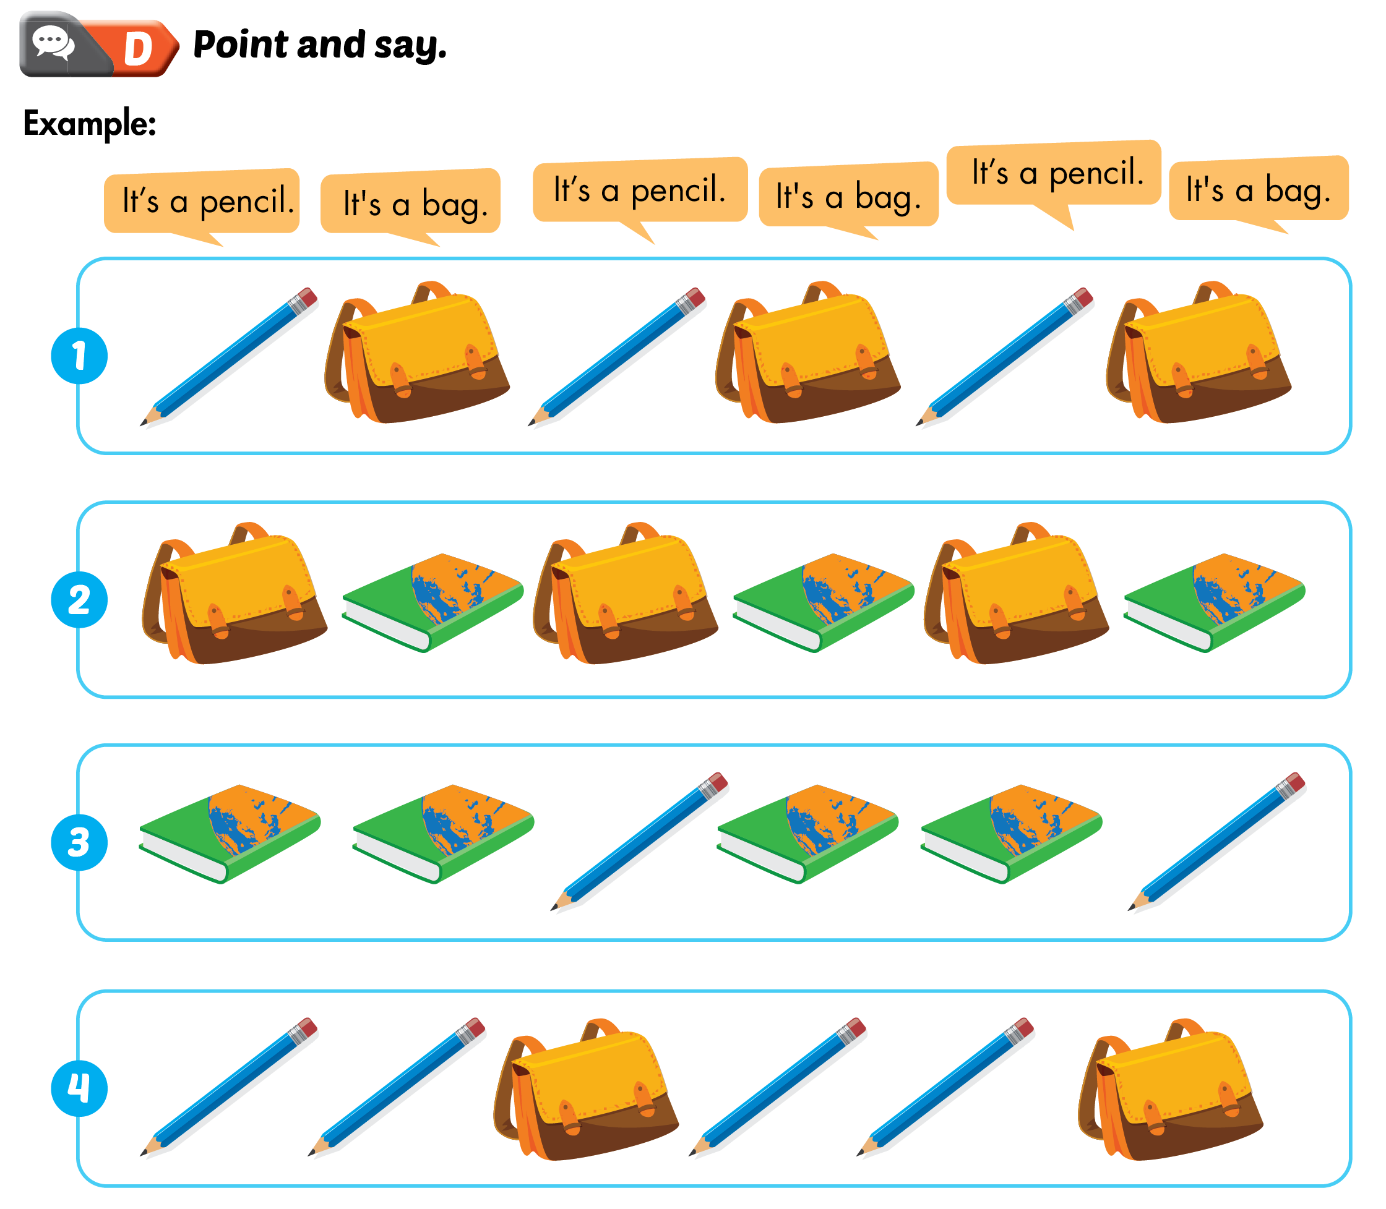
Lesson 1

Slide 4
Lesson 1

Slide 6
Lesson 2

Slide 7
Lesson 2

Slide 8
Lesson 2

Slide 9
Lesson 2

Slide 11
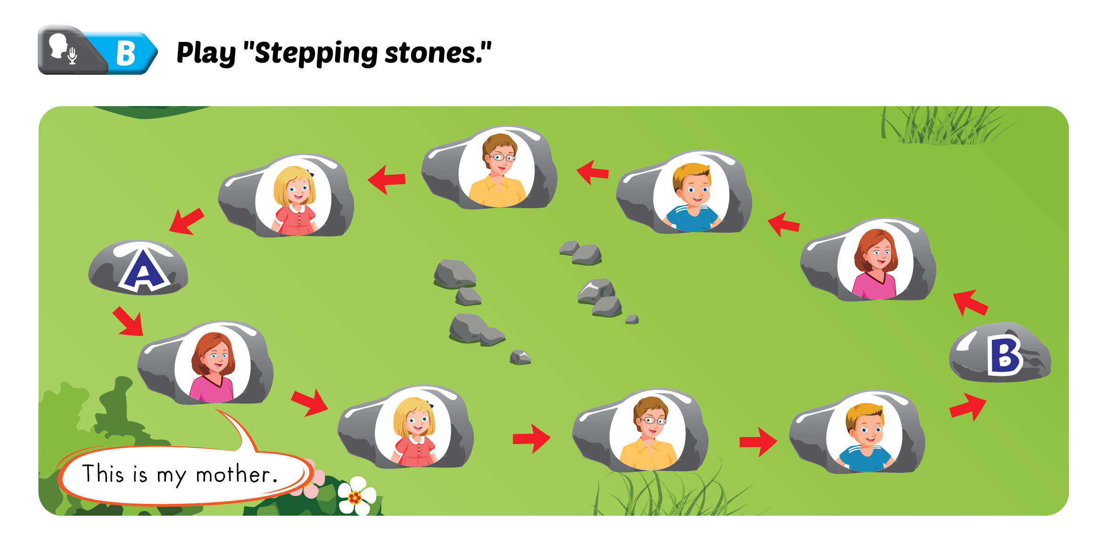

Slide 13
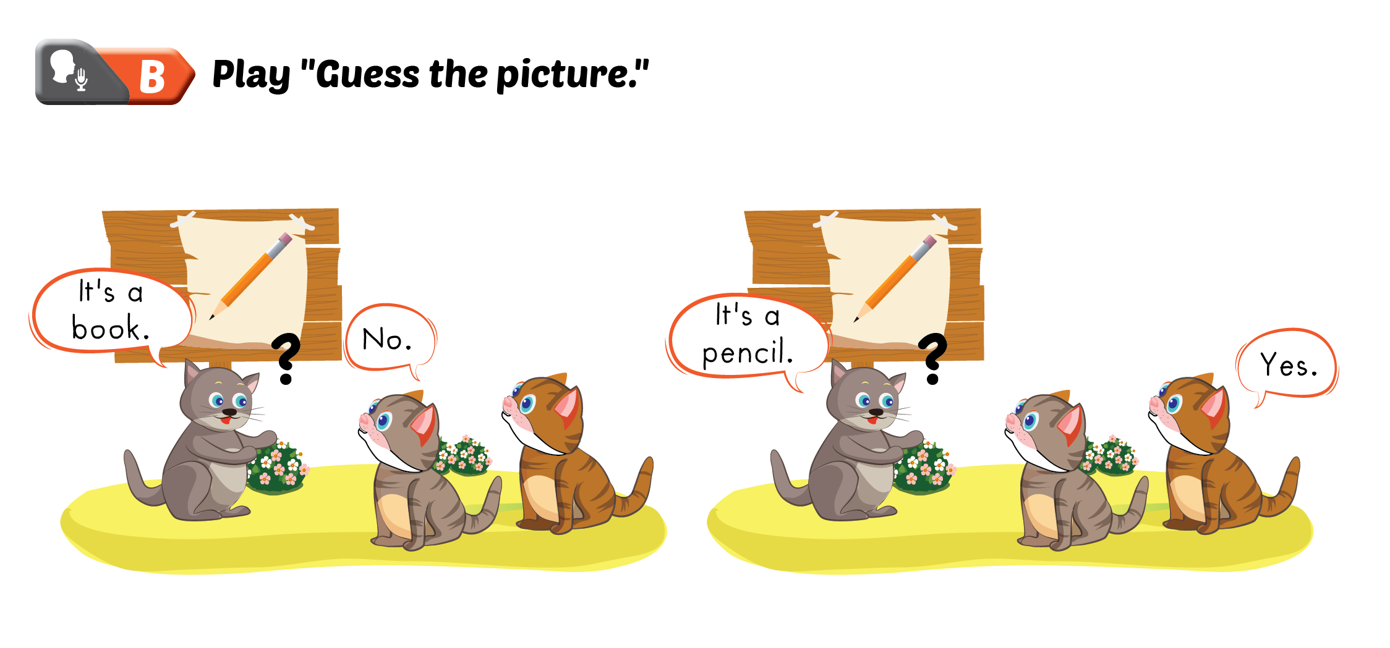
Lesson 1

