Slide 2
Tuesday, November 16th, 2021
Unit 5. Free time activities
Lesson 1. Part A,B,C

Slide 3
I. Vocabulary

Slide 4
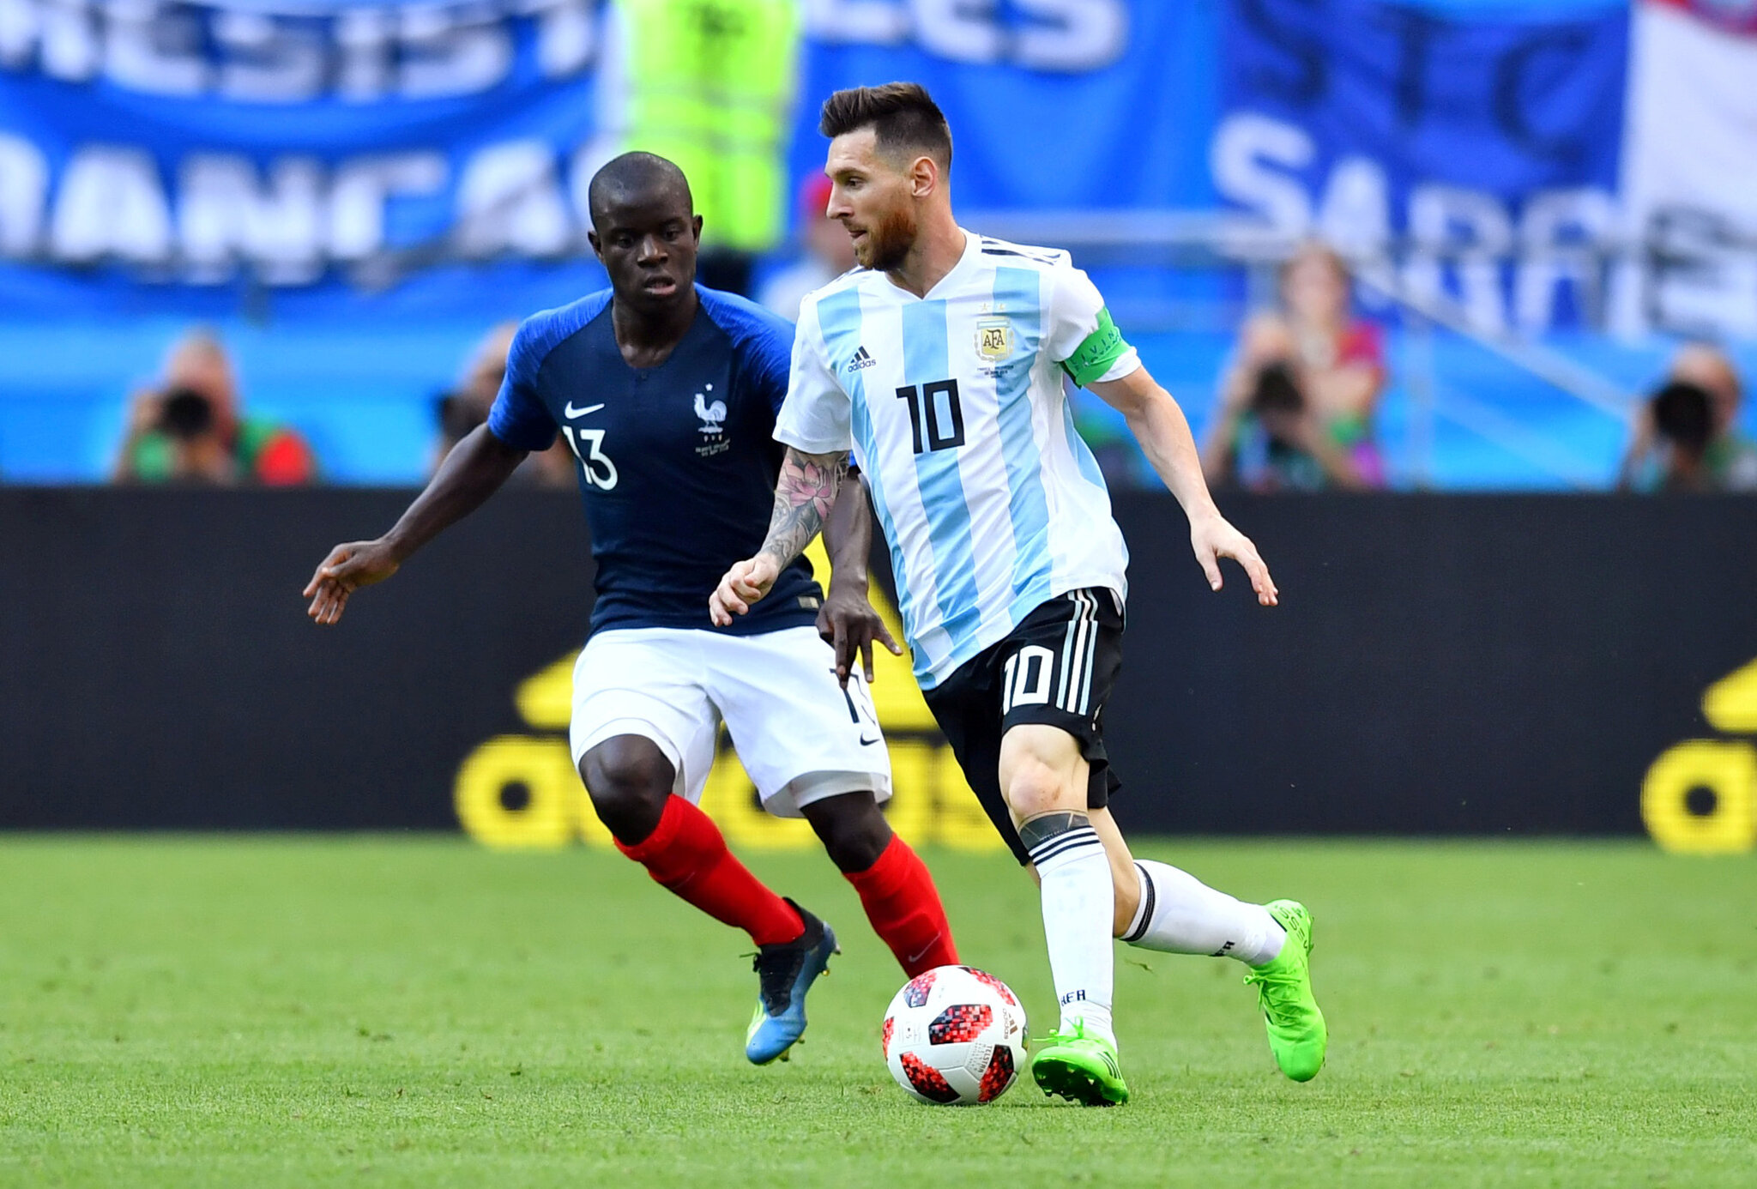
soccer

Slide 5
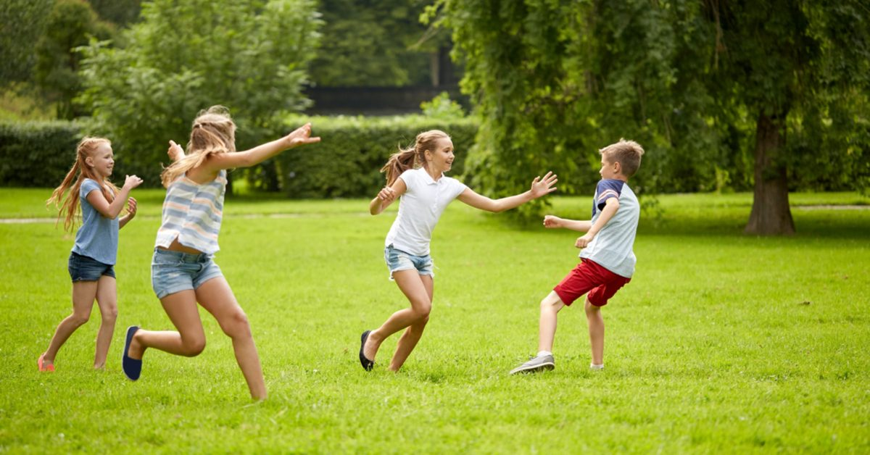
tag

Slide 6
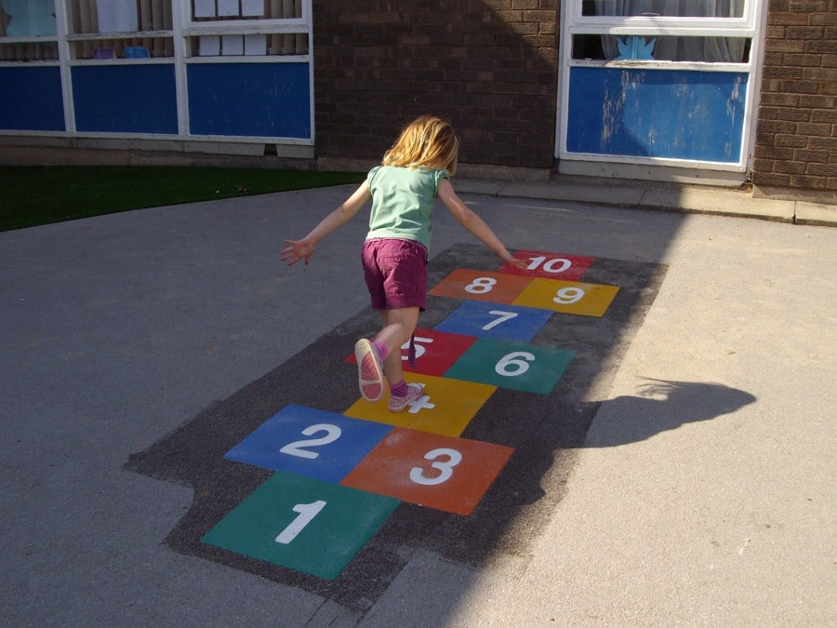
hopscotch

Slide 7
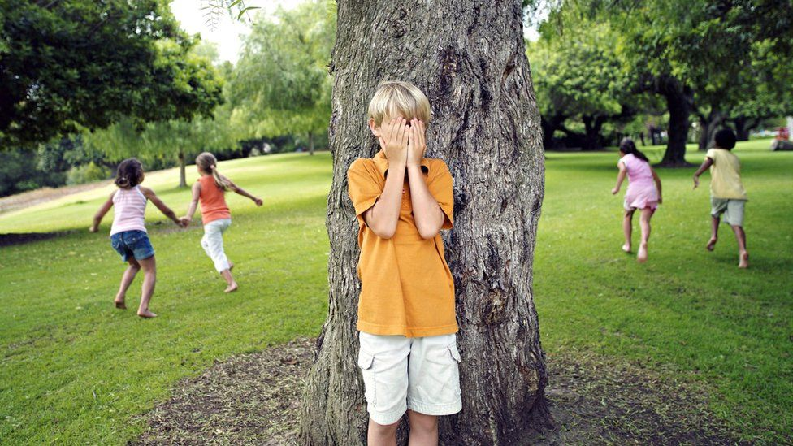
Hide and seek

Slide 8
Free time activities
soccer
tag
hopscotch
hide and seek

Slide 9
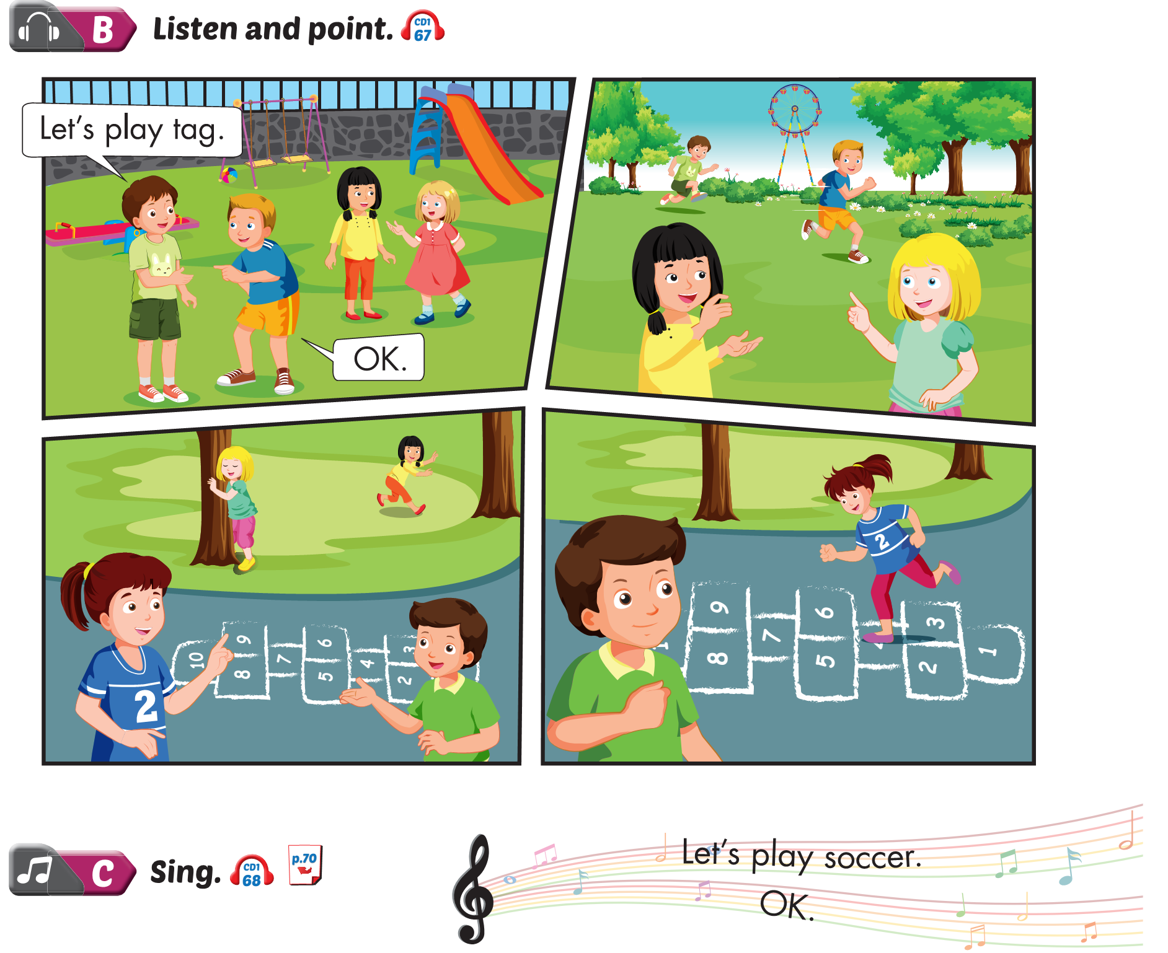

Slide 10
II. Sentence patterns
Ok.
Let’s play……

Slide 11
Notes:
Ms Huyền Phạm - 0936.082.789 – YOUTUBE: MsPham. Facebook: Dạy và học cùng công nghệ.

Slide 12
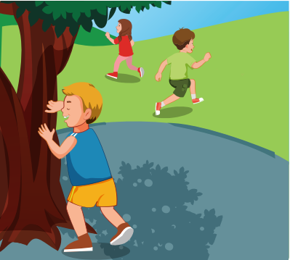
Câu hỏi 3
Tag
Hide and seek
+5
-1
-1
-1
Listen
Swim
Notes:
Ms Huyền Phạm - 0936.082.789 – YOUTUBE: MsPham. Facebook: Dạy và học cùng công nghệ.

Slide 13
Câu hỏi 2
Run
Soccer
+5
-1
-1
-1
Tag
Hopscotch
Notes:
Ms Huyền Phạm - 0936.082.789 – YOUTUBE: MsPham. Facebook: Dạy và học cùng công nghệ.

Slide 14
Câu hỏi 1
Let’s play soccer
Let’s play hopscotch
+5
-1
-1
-1
Close your book
Hands up
Notes:
Ms Huyền Phạm - 0936.082.789 – YOUTUBE: MsPham. Facebook: Dạy và học cùng công nghệ.

Slide 15
Câu hỏi 4
Hide and seek
Let’s play tag
+5
-1
-1
-1
Close your book
Let’s sing
Notes:
Ms Huyền Phạm - 0936.082.789 – YOUTUBE: MsPham. Facebook: Dạy và học cùng công nghệ.

Slide 16
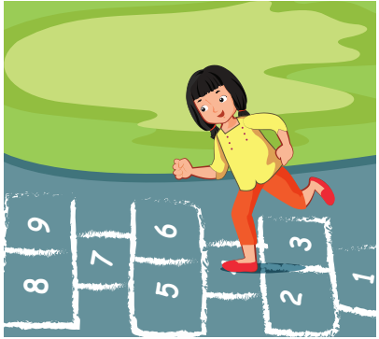
Câu hỏi 3
Sing
Let’s play hopscotch
+5
-1
-1
-1
Hide and seek
Tag
Notes:
Ms Huyền Phạm - 0936.082.789 – YOUTUBE: MsPham. Facebook: Dạy và học cùng công nghệ.

Slide 17
Listen and choose the correct answer
Swim
Soccer
+5
-1
-1
-1
Hide and seek
Hopscotch
Notes:
Ms Huyền Phạm - 0936.082.789 – YOUTUBE: MsPham. Facebook: Dạy và học cùng công nghệ.

Slide 18
Great job!
Exit
8
13
Notes:
Ms Huyền Phạm - 0936.082.789 – YOUTUBE: MsPham. Facebook: Dạy và học cùng công nghệ.

Slide 20
Thank you for your attention!

