Slide 1
Unit 7: clothes.

Slide 2
T-shirt

Slide 3
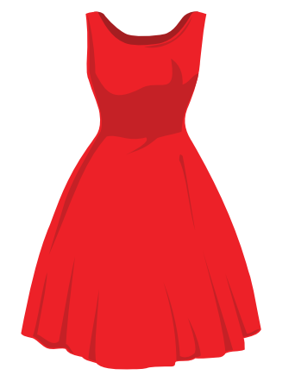
dress

Slide 4
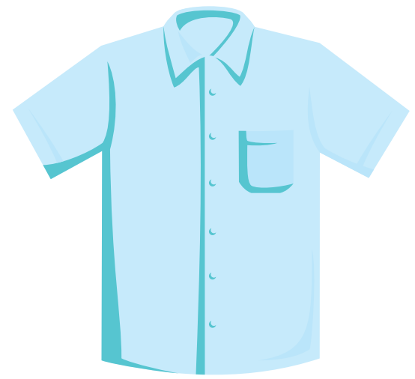
shirt

Slide 5
Hat.

Slide 7
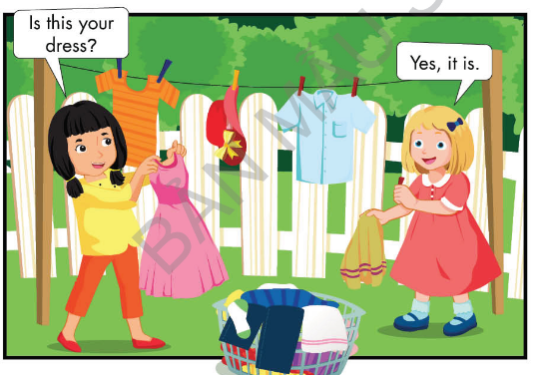

Slide 8
Yes, it is or No, it isn’t
Game

Slide 9
Is this your hat?
Great!
Yes, it is
No, it isn’t

Slide 10
Is this your T-shirt?
Great!
Yes, it is
No, it isn’t

Slide 11
Is this your shirt?
Great!
Yes, it is
No, it isn’t

Slide 12
Is this your T-shirt?
Great!
No, it isn’t.
Yes, it is

Slide 13
Is this your dress?
Great!
Yes, it is
No, it isn’t

Slide 14
Great Job!

Slide 15
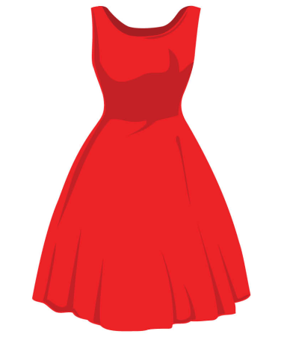
Listen and put a ( )or a ( ).
Touch the picture and see the correct answer.
1
2
3

Slide 16
Sing.

Slide 17
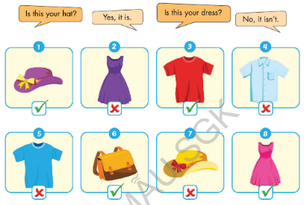

Slide 18
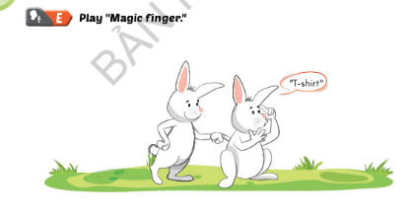

Slide 20
Listen and repeat. Write.
……iolin
……est

Slide 21
Sing.
I have a
V,v,
I have a
V,v,v.

Slide 22
Listen and jump.

Slide 23
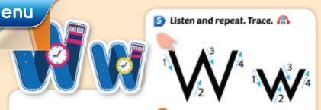

Slide 24
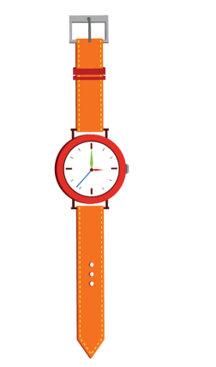
Listen and repeat. Write.
……atch
……indow

Slide 25
Sing.
It’s a
W, w.
It’s a
W, w, w.

Slide 26
Listen and clap.

Slide 27
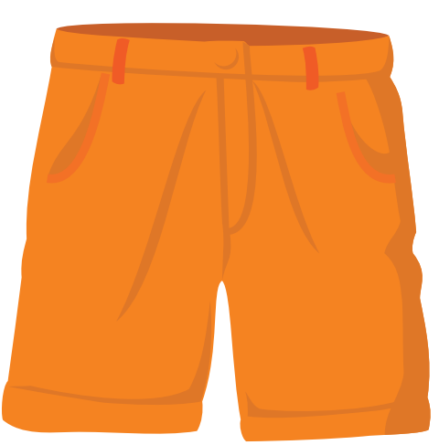
shorts

Slide 28
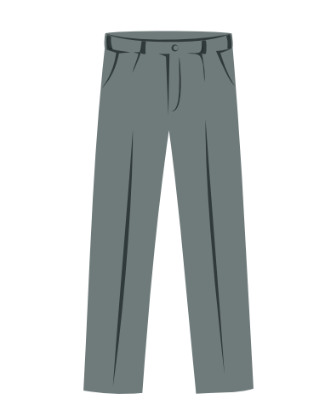
Pants

Slide 29
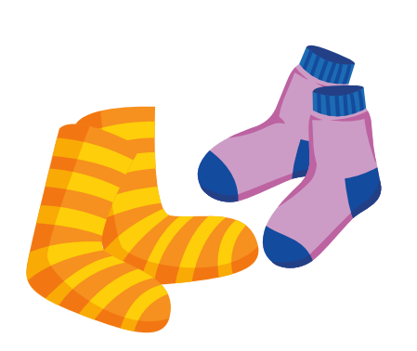
socks

Slide 30
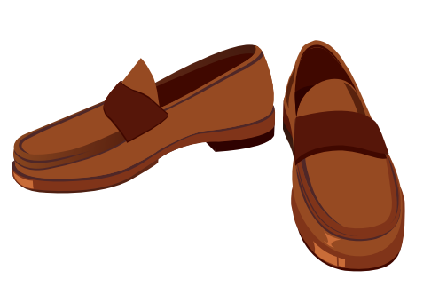
Shoes

Slide 32
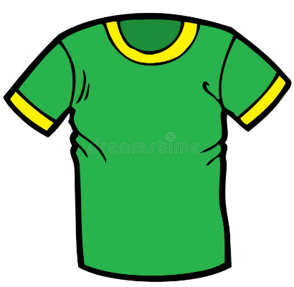
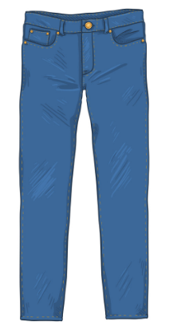
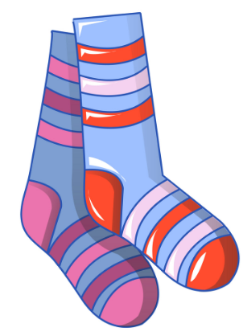
I want blue pants and greed T-shirt.

Slide 33
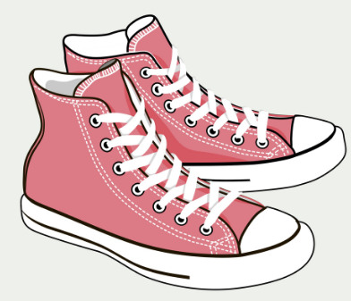
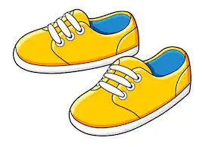
I want yellow shoes.

Slide 34
Draw lines. (Touch the picture and see correct answer).
T-shirt
Shoes
Cap

Slide 35
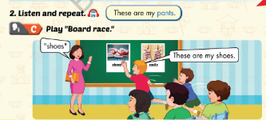

Slide 36
These is or These are
Game

Slide 37
There _____ a T-Shirt
Great!
is
are

Slide 38
These _____my pants.
Great!
is
are

Slide 39
These _____ my shoes.
Great!
are
is

Slide 40
These _____ my socks.
Great!
is
are

Slide 41
Great Job!

Slide 42
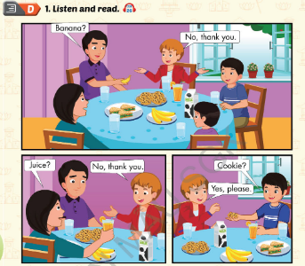

Slide 43
