Slide 2
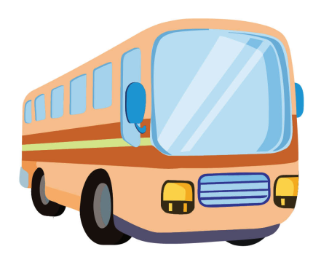
bus

Slide 3
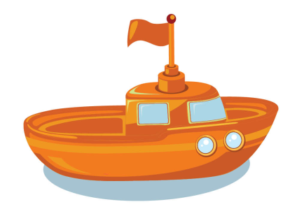
boat

Slide 4
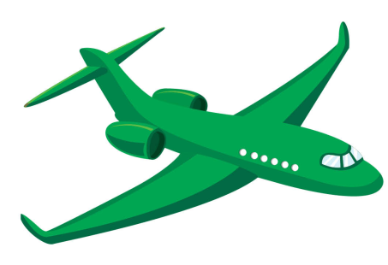
plane

Slide 5
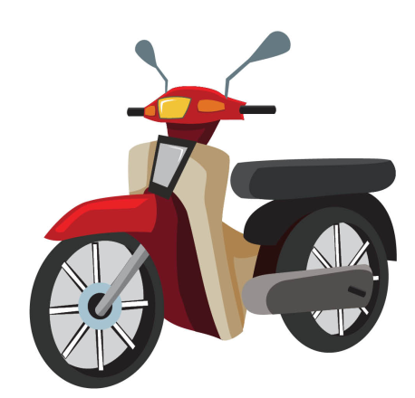
motorbike

Slide 6
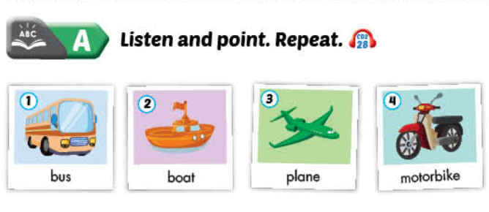

Slide 7
PLAY

Slide 8
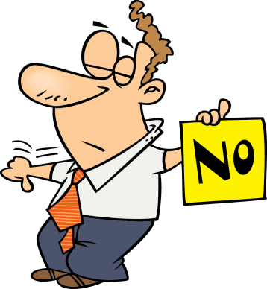
Can you see the boat.
No, I can’t.
Yes , I can.
No, I can’t.
NEXT

Slide 9
Can you see the plane?.
No, I can’t.
Yes, I can.
NEXT

Slide 10
Can you see the boat?
No, I can’t
Yes, I can.
NEXT

Slide 11
Can you see the motorbike?
Yes, I can.
Yes, I can.
No, I can’t
EXIT

Slide 12
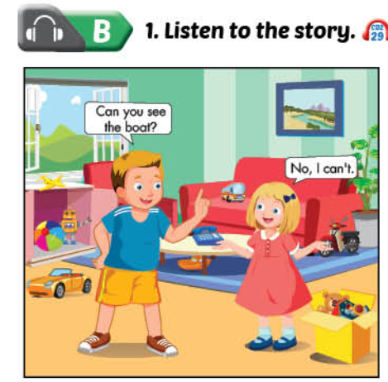

Slide 13
Touch the picture and see the correct answer.

Slide 15
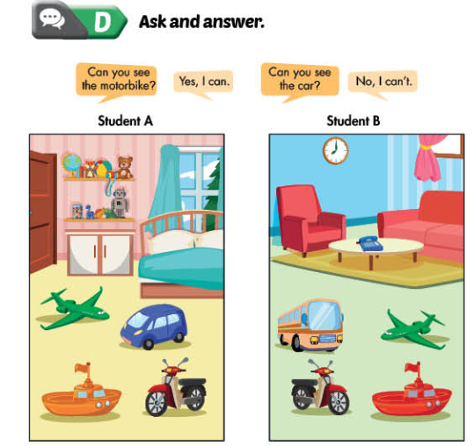

Slide 18
Sing the alphabet song.

Slide 19
A. Listen and repeat. Trace.
X
---------
---------
1
2
1
2
-----
-----

Slide 20
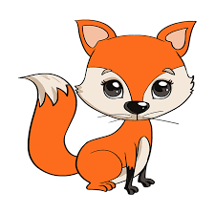
B. Listen and repeat. Write .
x x bo...
x x fo...
x
x

Slide 21
C. Sing .
I can see a
x, x,
I can see a
x, x, x.

Slide 22
D. Listen and hop.

Slide 23
E. Listen and repeat. Trace.
Y
Y
---------
---------
1
2
1
2
-----
-----
3
-----

Slide 24
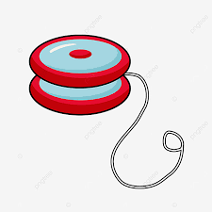
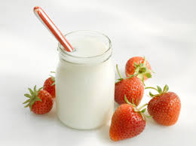
F. Listen and repeat. Write .
y
y
y
y y ...o…o
y y ...ogurt

Slide 25
G. Sing .
I have a , y, y,
I have a , y, y, y.

Slide 26
H. Listen and clap.

