Slide 1
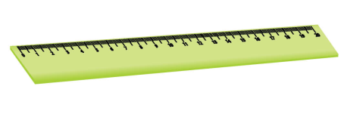
Listen and point. Repeat.
Eraser.
Ruler.
Crayon.
Pencil case

Slide 2
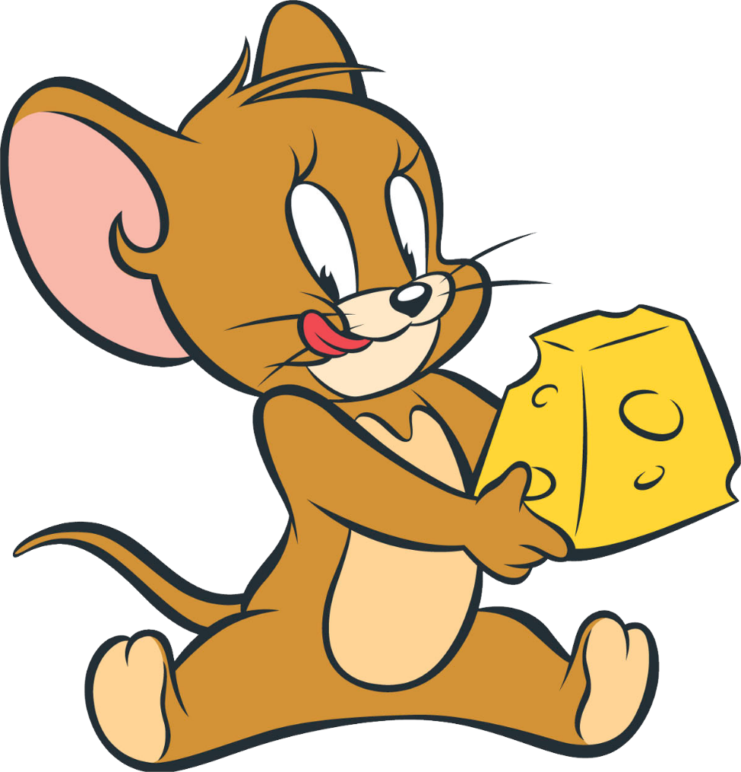
JERRY’S
DOOR
START

Slide 3
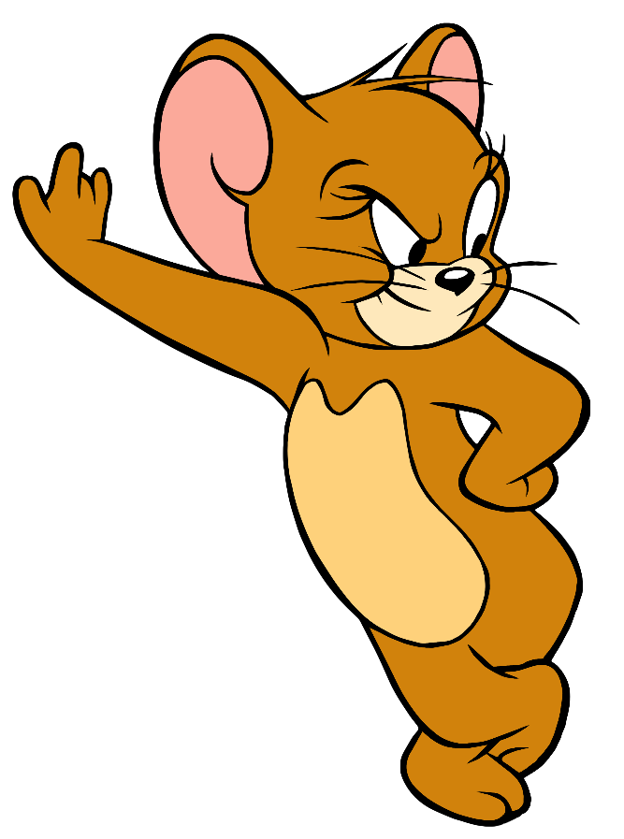
What is this?
CHECK
It is a crayon.

Slide 4
What is this?
CHECK
It is an eraser.

Slide 5
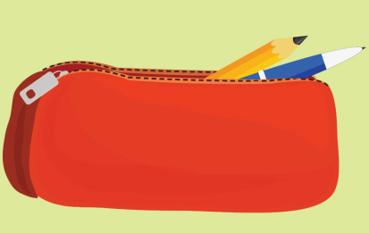
What is this?
CHECK
It is a pencil case.

Slide 6
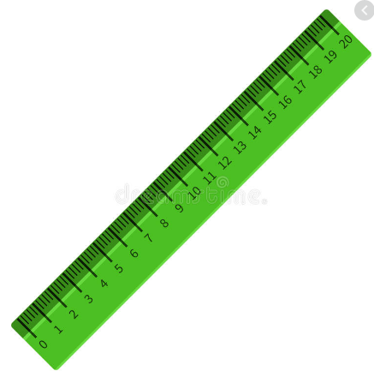
What is this?
CHECK
It is a ruler.

Slide 7
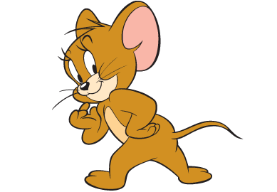
Well done!

Slide 8
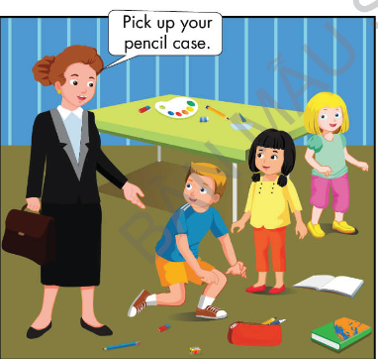

Slide 9
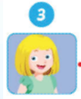
Touch and see the correct answer.

Slide 10
Sing.

Slide 11
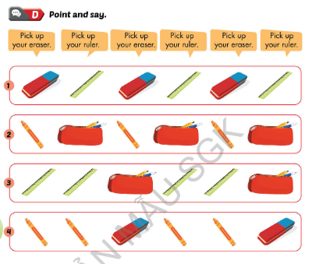

Slide 12
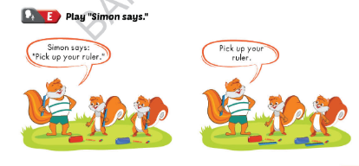

Slide 13
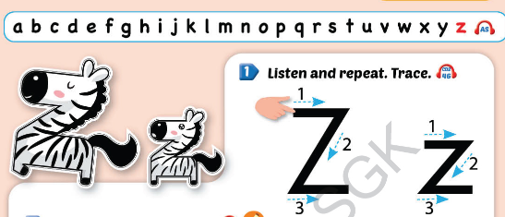

Slide 14
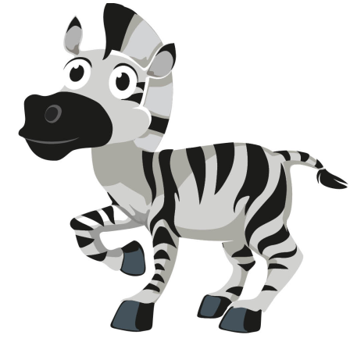
Listen and repeat. Write.
….ebra.
….oo.

Slide 15
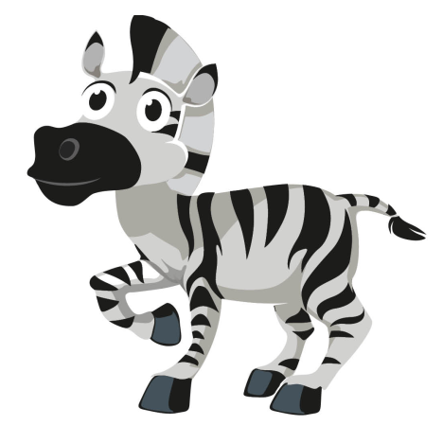
e
z
?
z
e
b
r
a

Slide 16
z
i
?
z
o
o

Slide 17
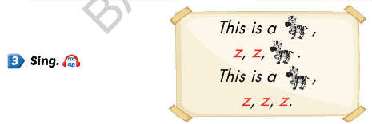

Slide 18
Listen and jump.

Slide 20
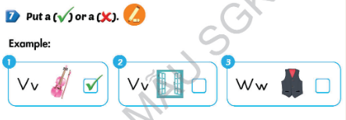

Slide 21
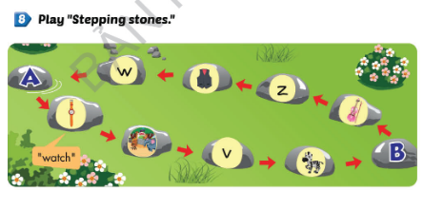

Slide 22
Lesson 3.

Slide 25
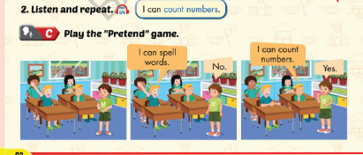

Slide 26
