Slide 1
Powerpoint thật dễ
Mspham
Unit 1
Hello
Lesson 1
Teacher: Ms. Huyền Phạm

Slide 2
A. Vocabulary
Hi
Hello
/haɪ/
/həˈləʊ/

Slide 3
A. Vocabulary
Nice to meet you
Miss
/naɪs tuː miːt ju/
/mɪs/
Rất vui được gặp bạn
Cô

Slide 4
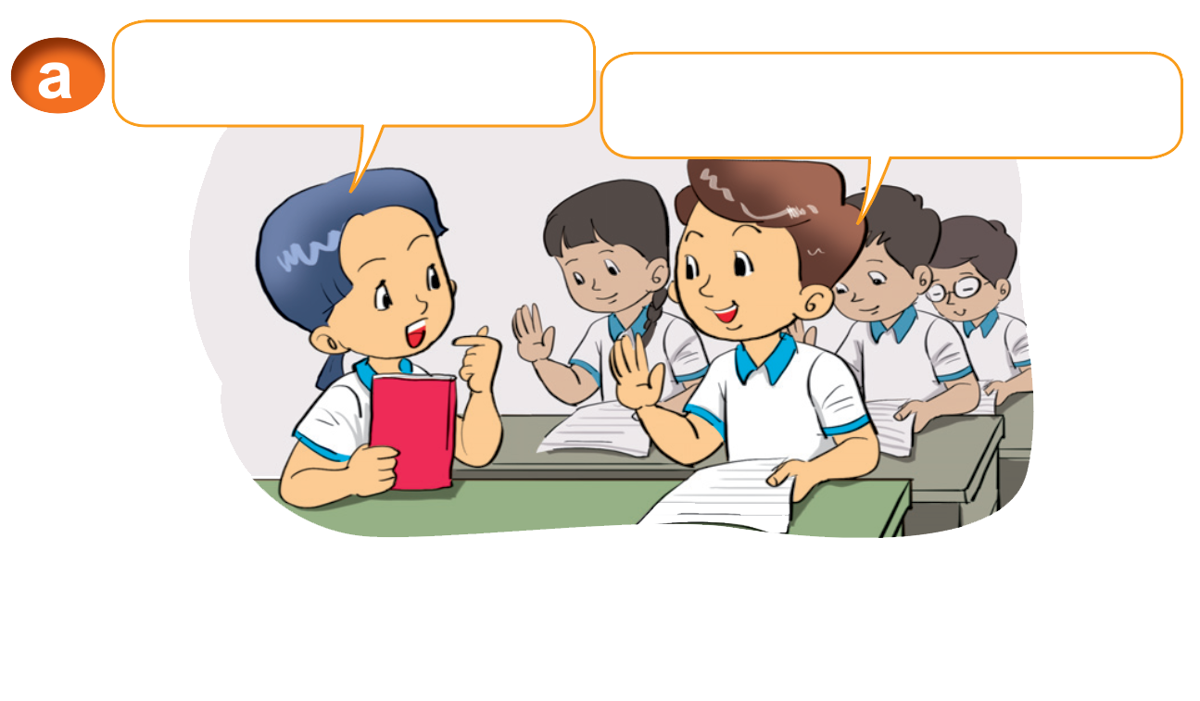
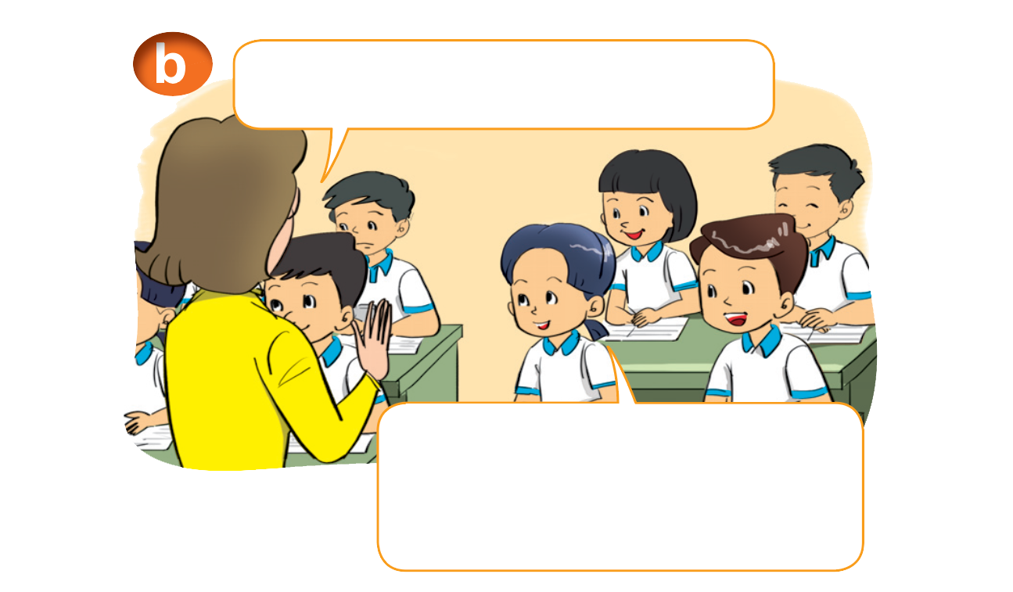
1. Look, listen and reapeat
Hello. I'm Mai.
Hi, Mai. I'm Nam.
Hello. I'm Miss Hien.
Hello, Miss Hien. Nice to meet you.

Slide 5
B. Structrures
Giới thiệu tên mình:
I am + name (tên).
(Tớ là ...)
I am = I’m

Slide 6
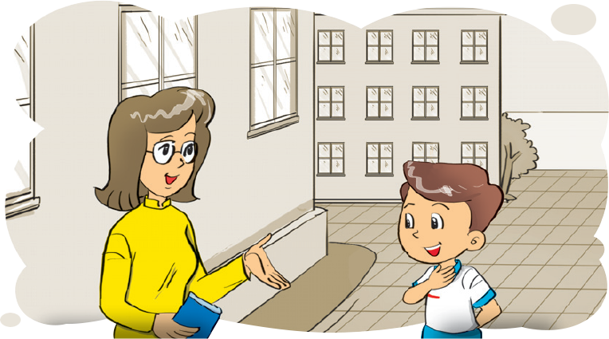
2. Point and say
Hello. I'm _____.
Hello. I'm _________.
Mai
Miss Hien
1
2
Hello _________. I'm __________.
Hello _______. I'm _______.
Miss Hien
Mai
Nam
Quan

Slide 8
____. I'm Mai.
Hi, Mai. I'm Nam.
Hello
Bye

Slide 9
Hello. I’m _______.
Linda
Miss Hien

Slide 10
Hello. ___ _________.
Miss Hien
Hello _________. I'm ___________.
Miss Hien
Nam
I am
I’s

Slide 11
Hello. ___ am Tony.
I’m
I

Slide 12
Hello. I'm Mai.
Hi, Mai. ___ Nam.
am
I’m

Slide 13
Hello. _______ Nam.
I am
I’am

Slide 14
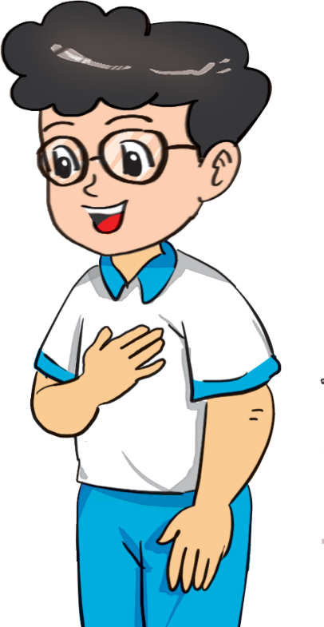
Hello. _______.
Phong
I’m Phong

Slide 16
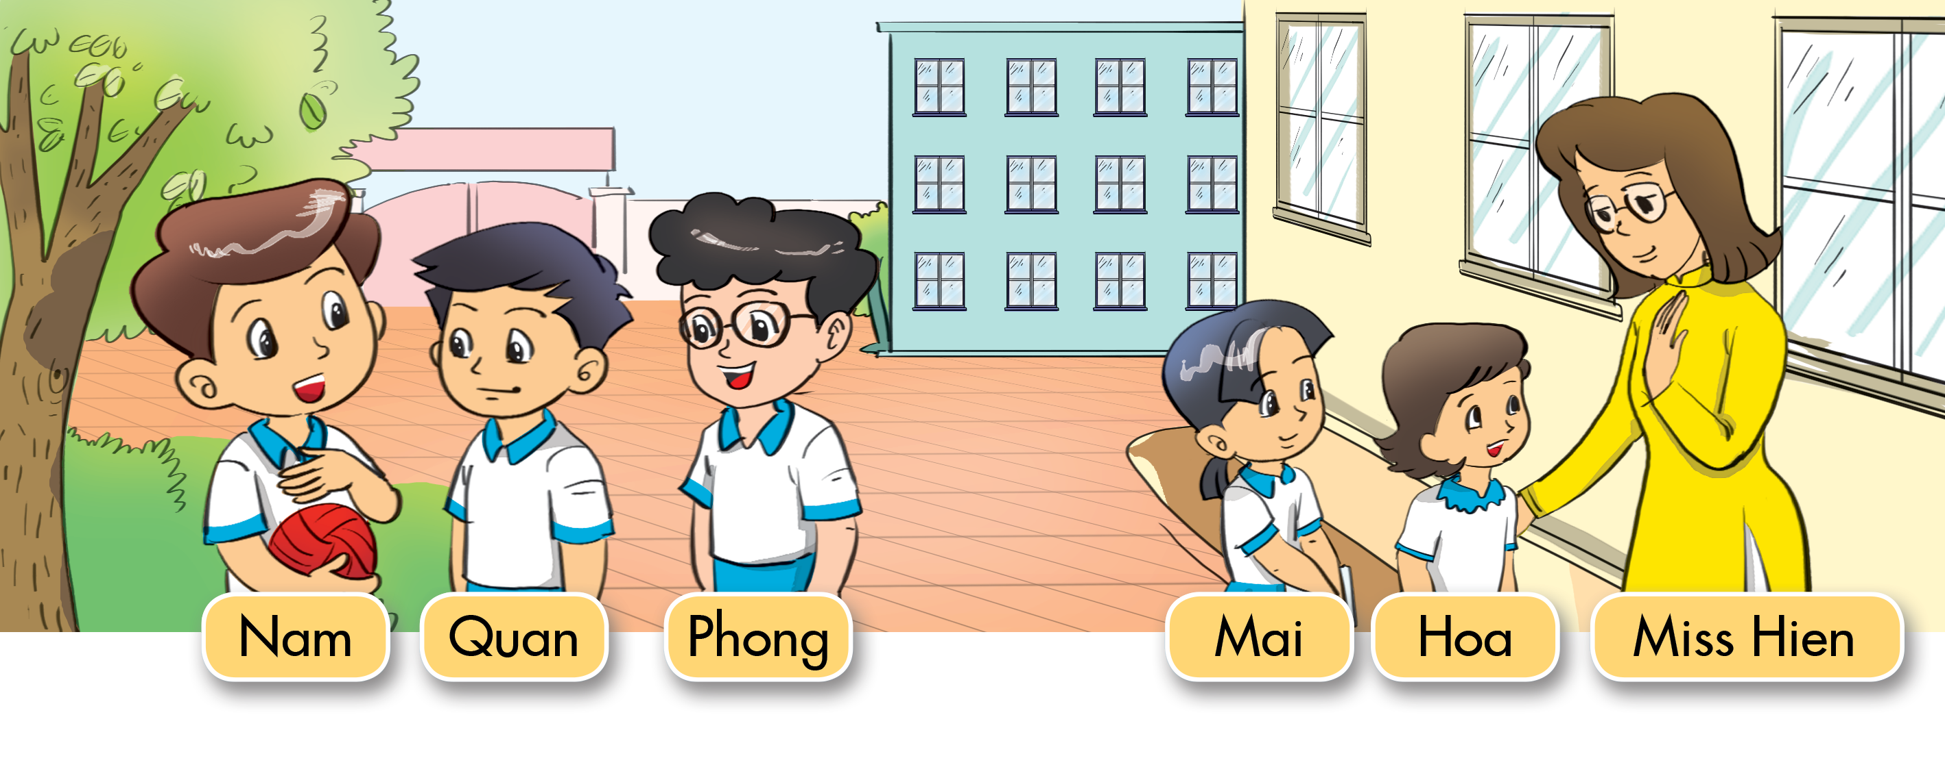
3. Let’s talk
Nam
Hello, I'm _______.
Hello, I'm _________.
Miss Hien
Hello, I'm ______.
Quan
Hoa
Hello, I'm _____.
Hello, I'm ______.
Phong
Hello, I'm ______.
Mai

Slide 17
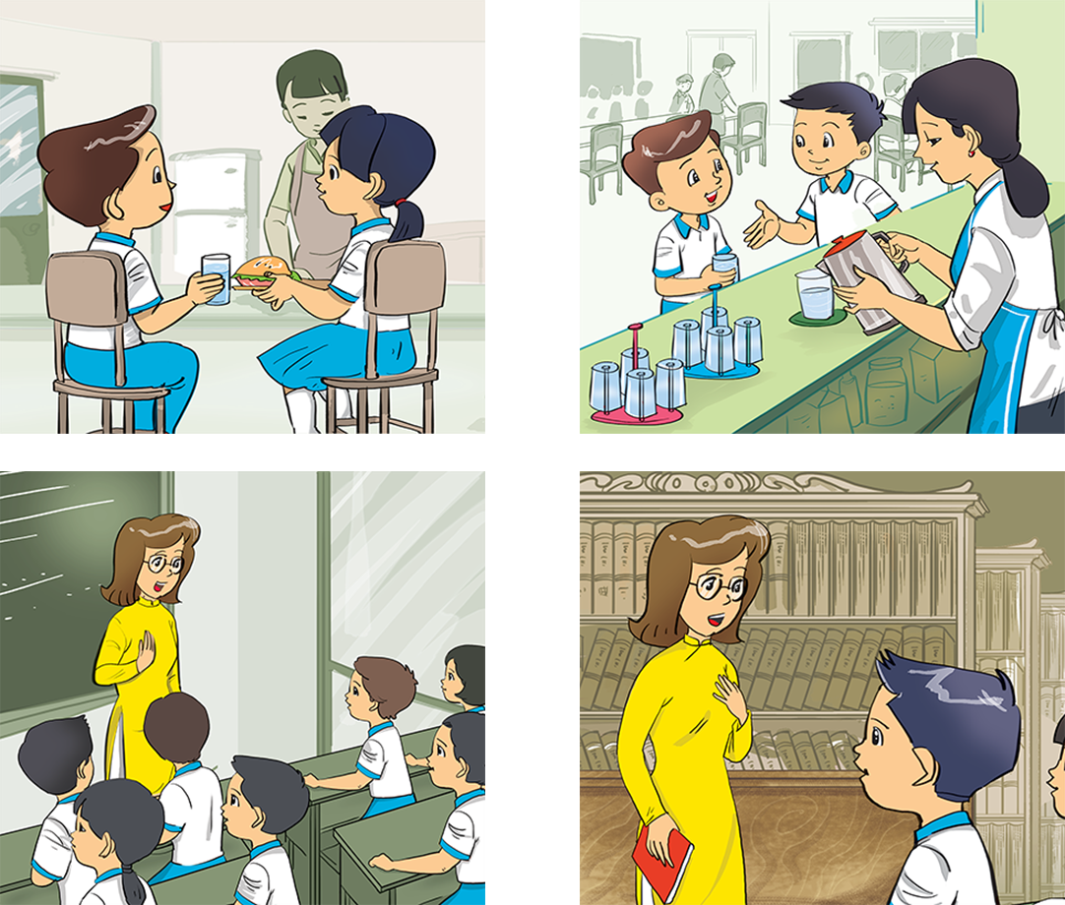
4. Listen and tick.
a
b
1
a
b
2

Slide 18
5. Let's write.
I'm
Hello
Mai: _______. I'm Mai.
Nam: Hi, Mai. _______ Nam.
Miss Hien: Hello. _______ Miss Hien.
Class: _______, Miss Hien. Nice to meet you.
Hello
1
I'm
I'm
2
Hello

Slide 19
6. Let's sing.

Slide 20
THANK YOU!
Welcome to join with me!
MsPham Powerpoint
Mspham

