Slide 1
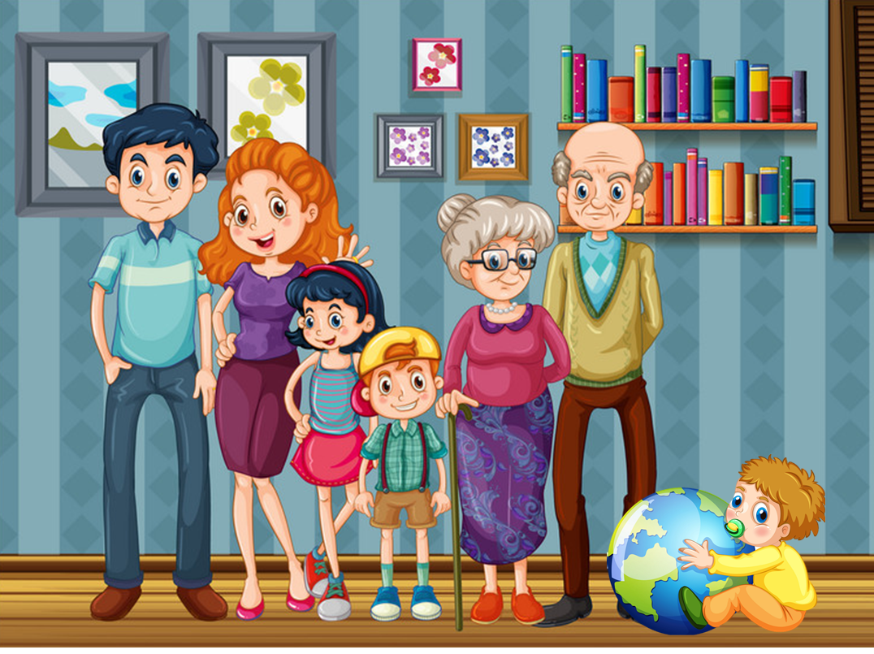
Unit 11
This is my family
Lesson 1

Slide 2
Family
/ˈfæmɪli/

Slide 3
Grandfather
/ˈgrændˌfɑːðə/

Slide 4
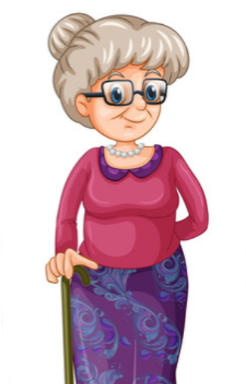
Grandmother
/ˈgrænˌmʌðə/

Slide 5
Father
/ˈfɑːðə/

Slide 6
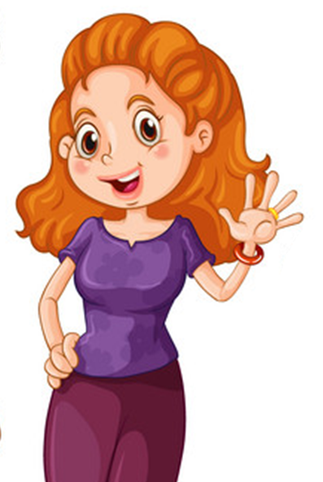
Mother
/ˈmʌðə/

Slide 7
Brother
/ˈbrʌðə/

Slide 8
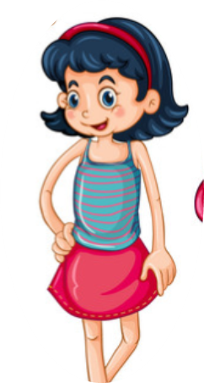
Sister
/ˈsɪstə/

Slide 9
Match
4
1
mother
grandfather
5
2
brother
father
3
sister
6
grandmother

Slide 10
Look, read and circle
Mother
Grandfather
Brother
Sister
Father
Grandmother
Grandmother
Grandfather
Father

Slide 11
Look, read and circle
Sister
Mother
Father
Father
Brother
Grandfather
Grandmother
Sister
Brother

Slide 12
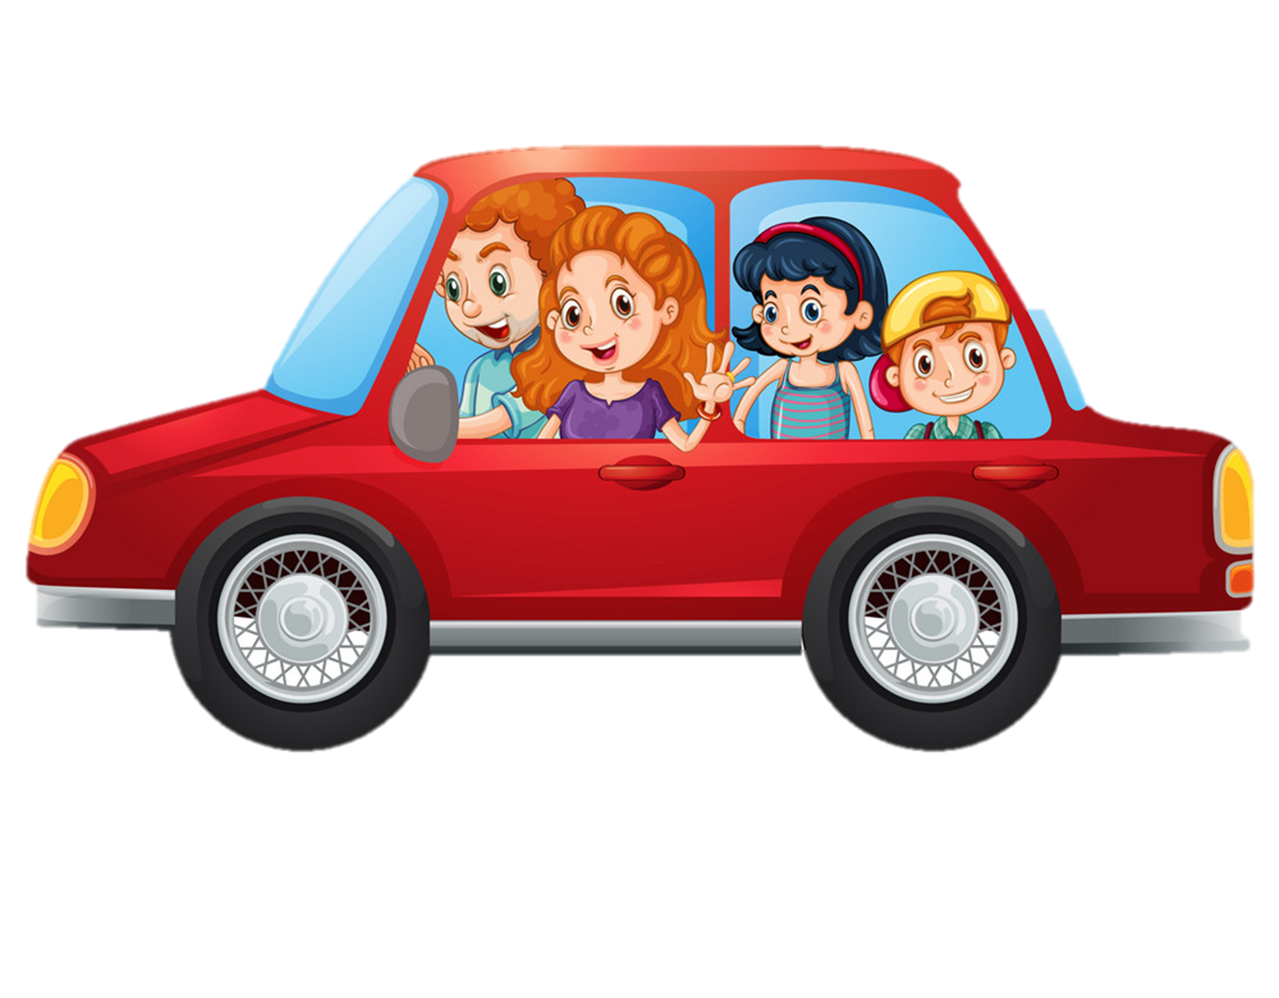
Vocabulary
/ˈfæmɪli/
/ ˈgrændˌfɑːðə/ / ˈgrænˌmʌðə/ / ˈfɑːðə/ / ˈmʌðə/ / ˈbrʌðə/ / ˈsɪstə/
- family
- grandfather
- grandmother
- father
- mother
- brother
- sister

Slide 13
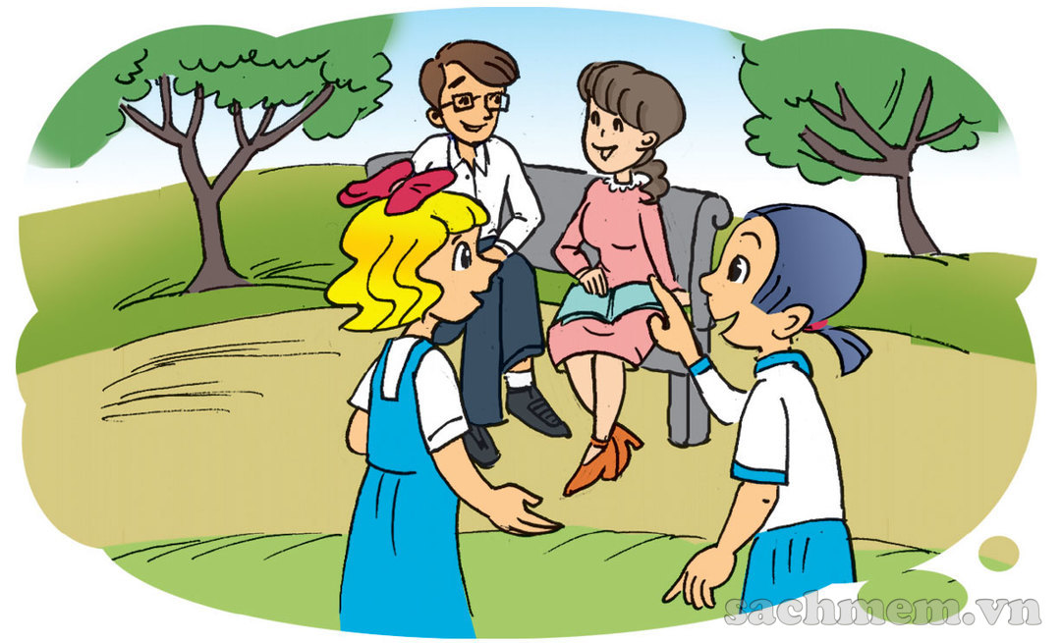
1. Look, listen and read
a
Who's that man?
He's my father.
Really? He's young!

Slide 14
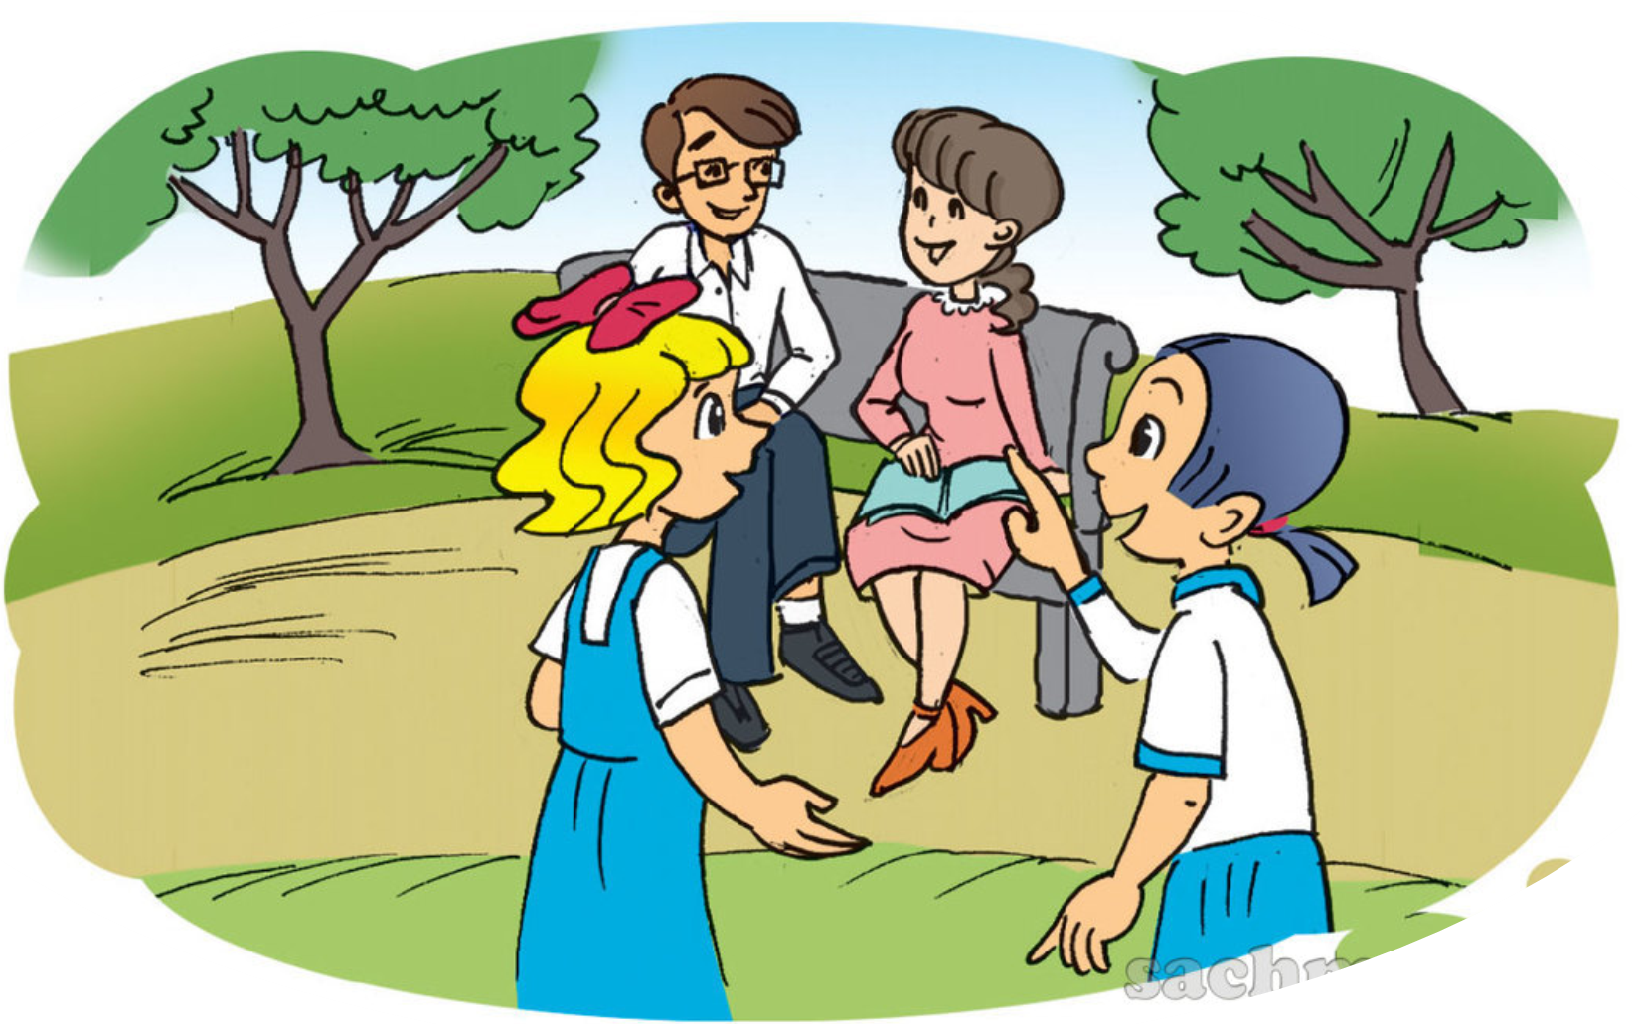
1. Look, listen and read
And that's my mother next to him.
b
She's nice!

Slide 15
2. Point and say
1
Who’s that?
She’s my grandmother.
________________________
2
Who’s that?
He’s my grandfather.
________________________

Slide 16
2. Point and say
3
Who’s that?
He’s my father.
___________
4
Who’s that?
She’s my mother.
_____________

Slide 17
2. Point and say
5
Who’s that?
He’s my brother.
_____________
6
Who’s that?
She’s my sister.
_________

Slide 18
Trò chơi
HÁI TÁO
Notes:
Ms Huyền Phạm - 0936.082.789 – YOUTUBE: MsPham. Facebook: Dạy và học cùng công nghệ.

Slide 19
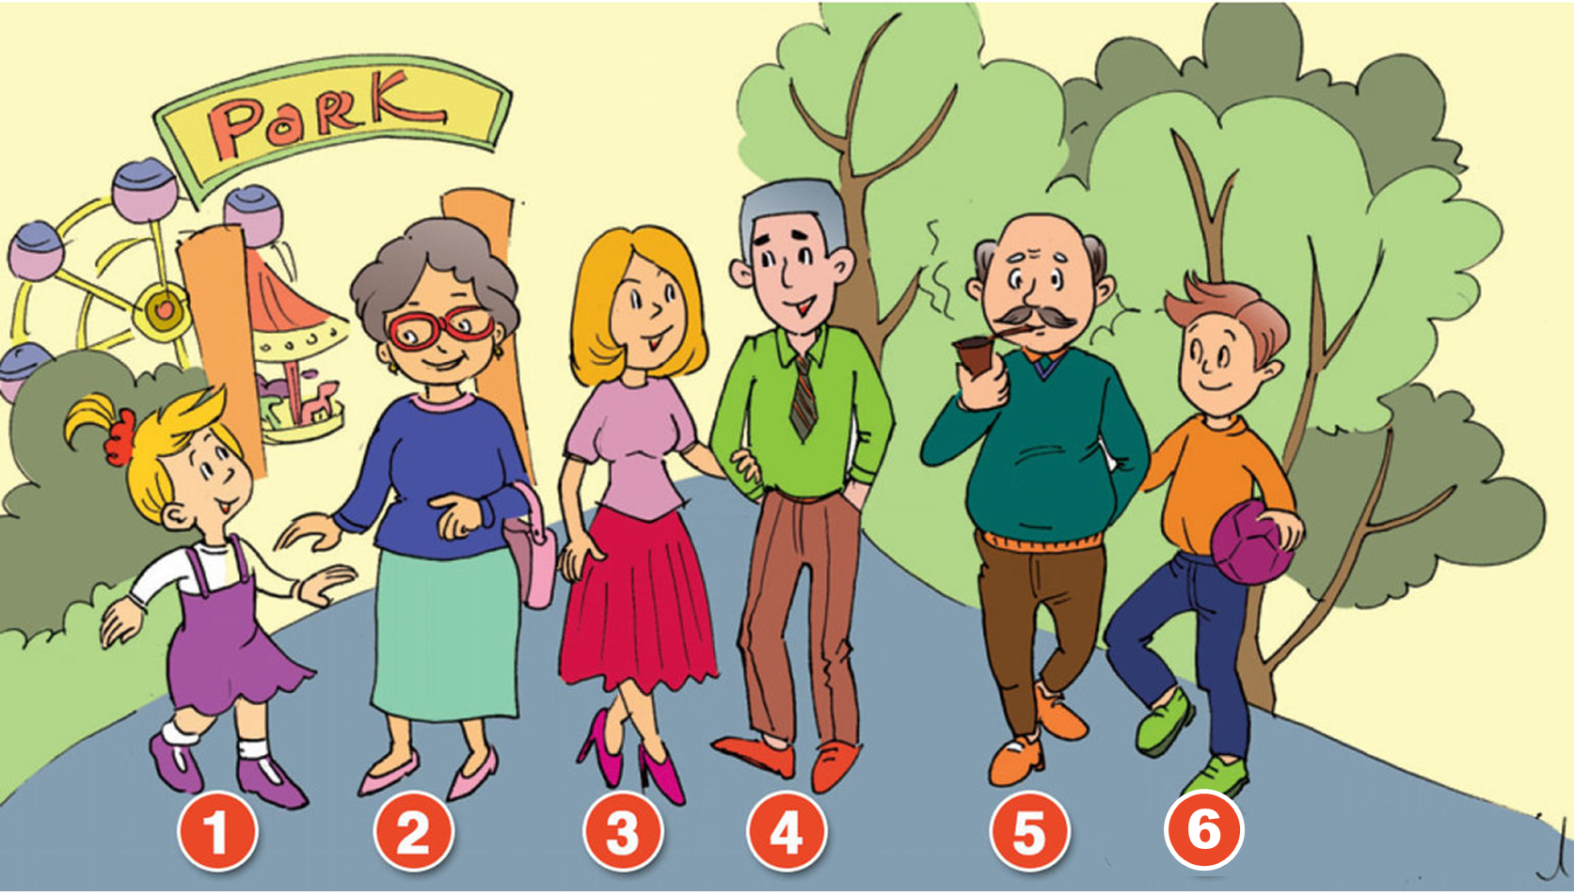
She
Who’s that?
____’s my grandfather.
A
He
B
You
C
Notes:
Ms Huyền Phạm - 0936.082.789 – YOUTUBE: MsPham. Facebook: Dạy và học cùng công nghệ.

Slide 20
Who’s
______ that?
She’s my mother.
A
What’s
B
How’s
C
Notes:
Ms Huyền Phạm - 0936.082.789 – YOUTUBE: MsPham. Facebook: Dạy và học cùng công nghệ.

Slide 21
Family
Who’s that?
She’s my _______.
A
Grandfather
B
Grandmother
C
Notes:
Ms Huyền Phạm - 0936.082.789 – YOUTUBE: MsPham. Facebook: Dạy và học cùng công nghệ.

Slide 22
She’s
Who’s that?
_____ my father.
A
He’s
B
He
C
Notes:
Ms Huyền Phạm - 0936.082.789 – YOUTUBE: MsPham. Facebook: Dạy và học cùng công nghệ.

Slide 23
She
Who’s that?
_____ my sister.
A
He
B
She’s
C
Notes:
Ms Huyền Phạm - 0936.082.789 – YOUTUBE: MsPham. Facebook: Dạy và học cùng công nghệ.

Slide 24
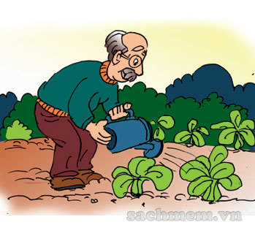
He’s my father.
Who’s that?
A
He’s my brother.
B
He’s my grandfather.
C
Notes:
Ms Huyền Phạm - 0936.082.789 – YOUTUBE: MsPham. Facebook: Dạy và học cùng công nghệ.

Slide 25
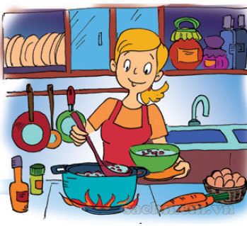
What’s that?
She’s my mother.
A
Who’s that?
B
How’s that?
C
Notes:
Ms Huyền Phạm - 0936.082.789 – YOUTUBE: MsPham. Facebook: Dạy và học cùng công nghệ.

Slide 26
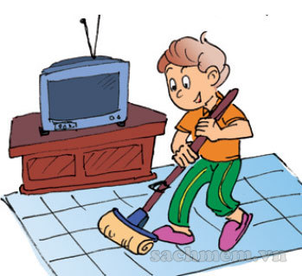
She’s my brother.
Who’s that?
A
He my brother.
B
He’s my brother.
C
Notes:
Ms Huyền Phạm - 0936.082.789 – YOUTUBE: MsPham. Facebook: Dạy và học cùng công nghệ.

Slide 27
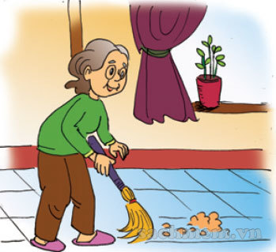
She’s my grandmother.
Who’s that?
_____________.
A
He’s my grandmother.
B
They’re my grandmother.
C
Notes:
Ms Huyền Phạm - 0936.082.789 – YOUTUBE: MsPham. Facebook: Dạy và học cùng công nghệ.

Slide 28
3. Let's talk
Who’s that?
He’s my grandfather.
Who’s that?
She’s my grandmother.
Who’s that?
He’s my brother.
Who’s that?
She’s my sister.
1
2
3
4
5
6
Who’s that?
She’s my mother.
Who’s that?
He’s my father.

Slide 29
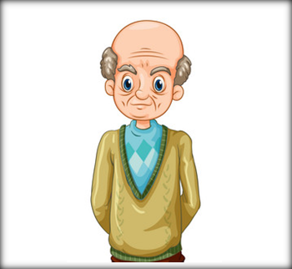
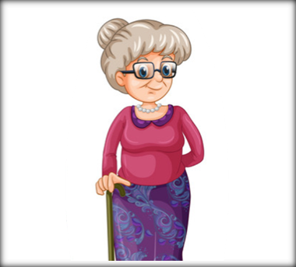
Model sentence
Who’s that?
_____’s my _______.
He
She
He
grandfather
She
He
mother
She
brother
father
grandmother
sister

Slide 30
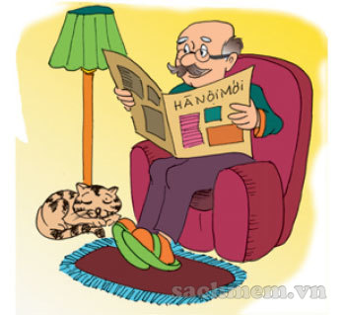
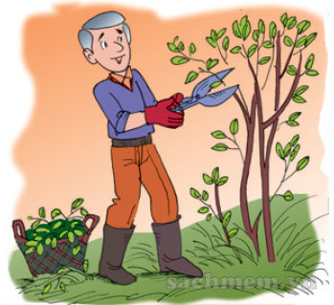
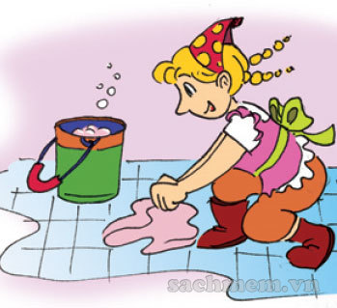
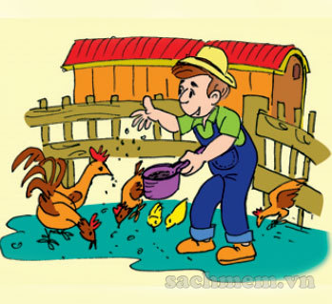
4. Listen
and tick
1
a.
b.
c.
2
a.
b.
c.
3
a.
b.
c.

Slide 31
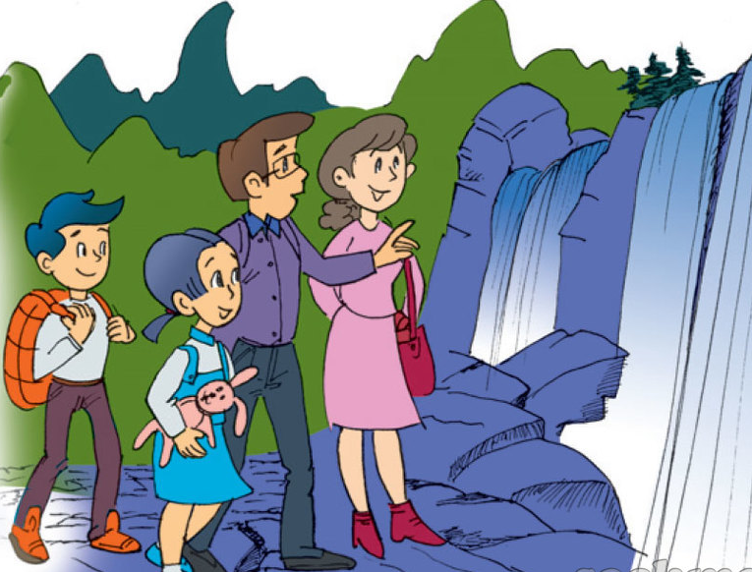
5. Read and complete.
1. This is a photo of Mai's family.
2. The man is her father.
3. The woman is her mother.
4. And the boy is her brother.
________.
________.
________.
________.

Slide 32
THANK YOU!
Welcome to join with me!
MsPham Powerpoint
Mspham

