Slide 1
Unit 12
This is my house
Lesson 1

Slide 2
WARM-UP

Slide 3
Read and match
1. Who's that man?
2. How old is your brother?
3. How old are you?
4. Is your grandfather old?
a. I'm ten.
b. Yes, he is.
c. He's thirteen.
d. He's my father.

Slide 4
VOCABULARY

Slide 5
House
/haʊs/

Slide 6
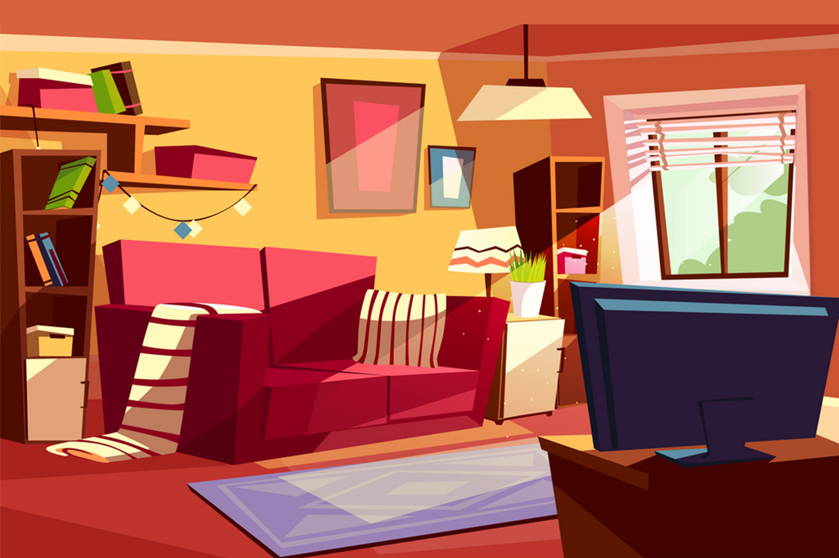
Living room
/ˈlɪvɪŋ ruːm/

Slide 7
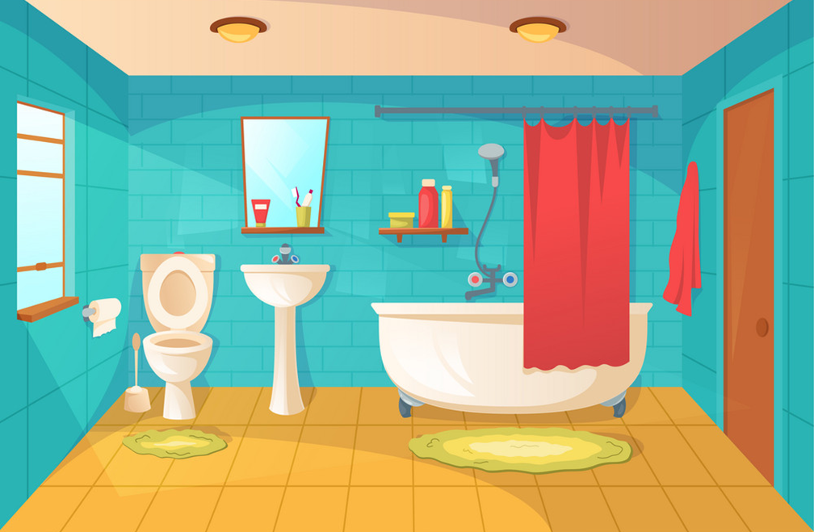
Bathroom
/ˈbæθruːm/

Slide 8
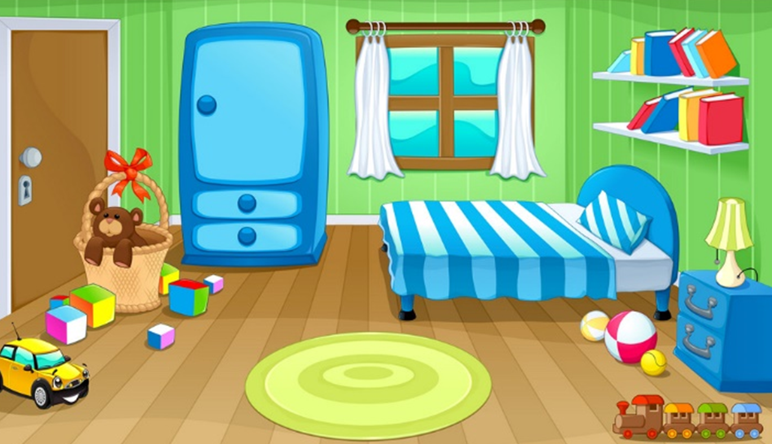
Bedroom
/ˈbedruːm/

Slide 9
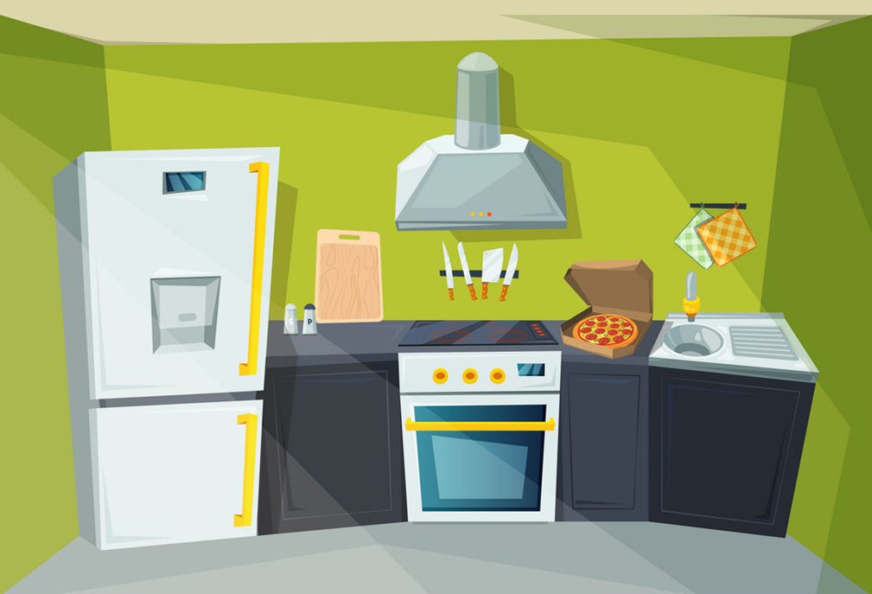
Kitchen
/ˈkɪtʃɪn/

Slide 10
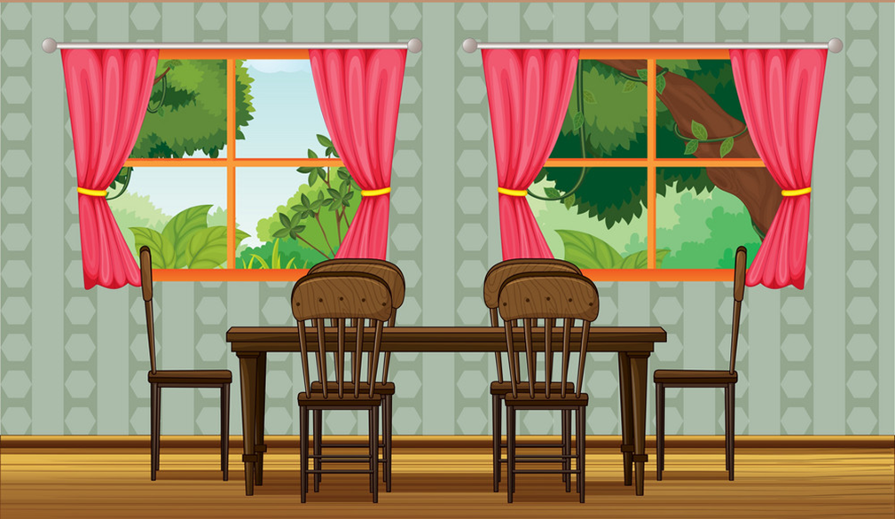
Dining room
/ˈdaɪnɪŋ ruːm/

Slide 11
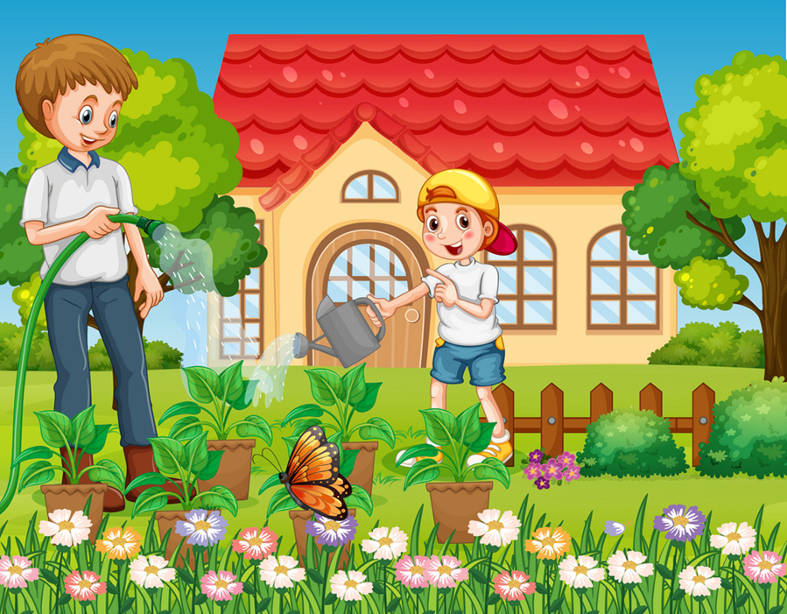
Garden
/ˈɡɑːrdn/

Slide 12
Vocabulary
Garden
House
Dining room
Bedroom
Living room
Kitchen
Bathroom

Slide 13
PLAY
Mario
PLAYING GOLF

Slide 14
This is my yard.
This is my garden.
This is my house.

Slide 15
This is my garden.
This is my house.
This is my kitchen.

Slide 16
This is my living room.
This is my dining room.
This is my bathroom.

Slide 17
That are my dining room.
That is my dining room.
This are my dining room.

Slide 18
That is my kitchen.
That is my living room.
That is my bathroom.

Slide 19
Those are my house.
That is my house.
These are my house.

Slide 20
WELLDONE!

Slide 21
Grammar

Slide 22
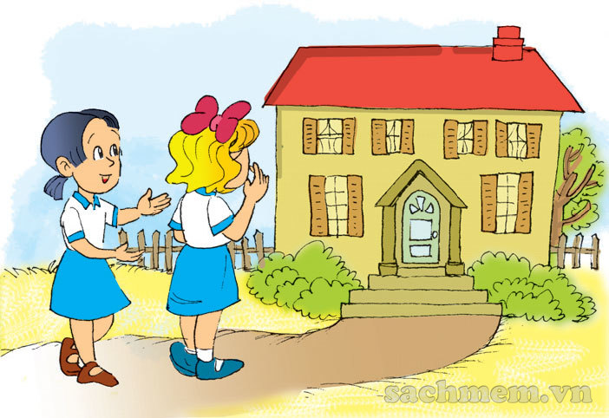
1. Look, listen and repeat.
This is my house.
Wow! It's big!

Slide 23
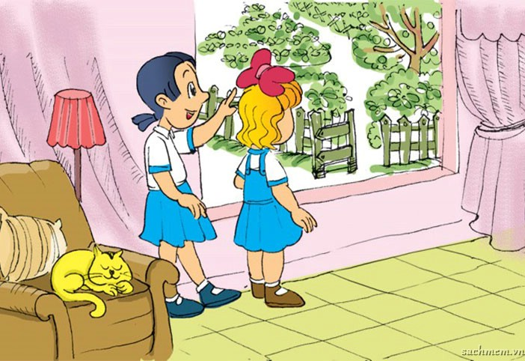
1. Look, listen and repeat.
There's a garden over there.
Come and see it.
It's very nice!

Slide 24
2. Point and say.
There's a living room.
_____________ .
It's very nice!

Slide 25
2. Point and say.
There's a bathroom.
_____________ .
It's very nice!

Slide 26
2. Point and say.
There's a bedroom.
_____________ .
It's very nice!

Slide 27
2. Point and say.
There's a kitchen.
_____________ .
It's very nice!

Slide 28
2. Point and say.
There's a dining room.
_____________ .
It's very nice!

Slide 29
2. Point and say.
There's a garden.
_____________ .
It's very nice!

Slide 30
3. Let's talk.
There's a kitchen.
1
2
3
Wow! It's very nice!
4
5

Slide 31
3. Let's talk.
There's a bedroom.
1
2
3
Wow! It's very nice!
4
5

Slide 32
3. Let's talk.
There's a bathroom.
1
2
3
Wow! It's very nice!
4
5

Slide 33
3. Let's talk.
There's a living room.
1
2
3
Wow! It's very nice!
4
5

Slide 34
3. Let's talk.
There's a dining room.
1
2
3
Wow! It's very nice!
4
5

Slide 35
4. Listen and tick.
a
a
a
b
b
b
1
2
3

Slide 36
Kiến chăm chỉ
PLAY

Slide 37
This is_________.
a house
Next
Notes:
Ms Huyền Phạm - 0936.082.789 – YOUTUBE: MsPham. Facebook: Dạy và học cùng công nghệ.

Slide 38
There is ________.
a living room
Next
Notes:
Ms Huyền Phạm - 0936.082.789 – YOUTUBE: MsPham. Facebook: Dạy và học cùng công nghệ.

Slide 39
There is _______.
a bedroom
Next
Notes:
Ms Huyền Phạm - 0936.082.789 – YOUTUBE: MsPham. Facebook: Dạy và học cùng công nghệ.

Slide 40
There is _________.
a dining room
Next
Notes:
Ms Huyền Phạm - 0936.082.789 – YOUTUBE: MsPham. Facebook: Dạy và học cùng công nghệ.

Slide 41
There is _______________.
a bathroom
Next
Notes:
Ms Huyền Phạm - 0936.082.789 – YOUTUBE: MsPham. Facebook: Dạy và học cùng công nghệ.

Slide 42
There is _________.
a kitchen
Next
Notes:
Ms Huyền Phạm - 0936.082.789 – YOUTUBE: MsPham. Facebook: Dạy và học cùng công nghệ.

Slide 43
There is __________.
a garden
Next
Notes:
Ms Huyền Phạm - 0936.082.789 – YOUTUBE: MsPham. Facebook: Dạy và học cùng công nghệ.

Slide 44
WELL DONE!
EXIT
Notes:
Ms Huyền Phạm - 0936.082.789 – YOUTUBE: MsPham. Facebook: Dạy và học cùng công nghệ.

Slide 45
5. Look and write
There is
a dining room.
_____________ .
This is a house.
_____________ .
There is
a bathroom.
_____________ .
There is
a living room.
_____________ .
There is a garden.
_____________ .
There is a bedroom.
_____________ .
There is a kitchen.
_____________ .

Slide 46
Model sentence
There is a ________.
It’s very nice.
bathroom
livingroom
kitchen
bedroom
garden
dining room

Slide 47
THANK YOU!
Welcome to join with me!
MsPham Powerpoint
Mspham

