Slide 1
Wednesday, 12 ^{th} January 2022
Unit 13: Where’s my book?
Lesson 1 – P123
1. Look, listen and repeat.

Slide 2
2. Point and say:
a. Vocabulary:
- Poster: tấm áp phích

Slide 3
- Bed: cái giường

Slide 4
- Chair: cái ghế

Slide 5
- Picture: bức tranh

Slide 6
- Coat: áo khoá

Slide 7
- Ball: quả bóng

Slide 8
PLAY

Slide 9
poster
chair
bed
picture

Slide 10
poster
coat
ball
bed

Slide 11
bed
coat
chair
ball

Slide 12
picture
bed
chair
poster

Slide 13
shirt
coat
supermaket
bookshop

Slide 14
ball
bed
KA
KO

Slide 15
End

Slide 16
b. Model sentence:
Where’s the ?
- It’s here/there.
* Where’s = Where is

Slide 17
3. Let’s talk
poster
bed
chair
Where’s the poster?
- It’s here.
picture
coat
ball

Slide 18
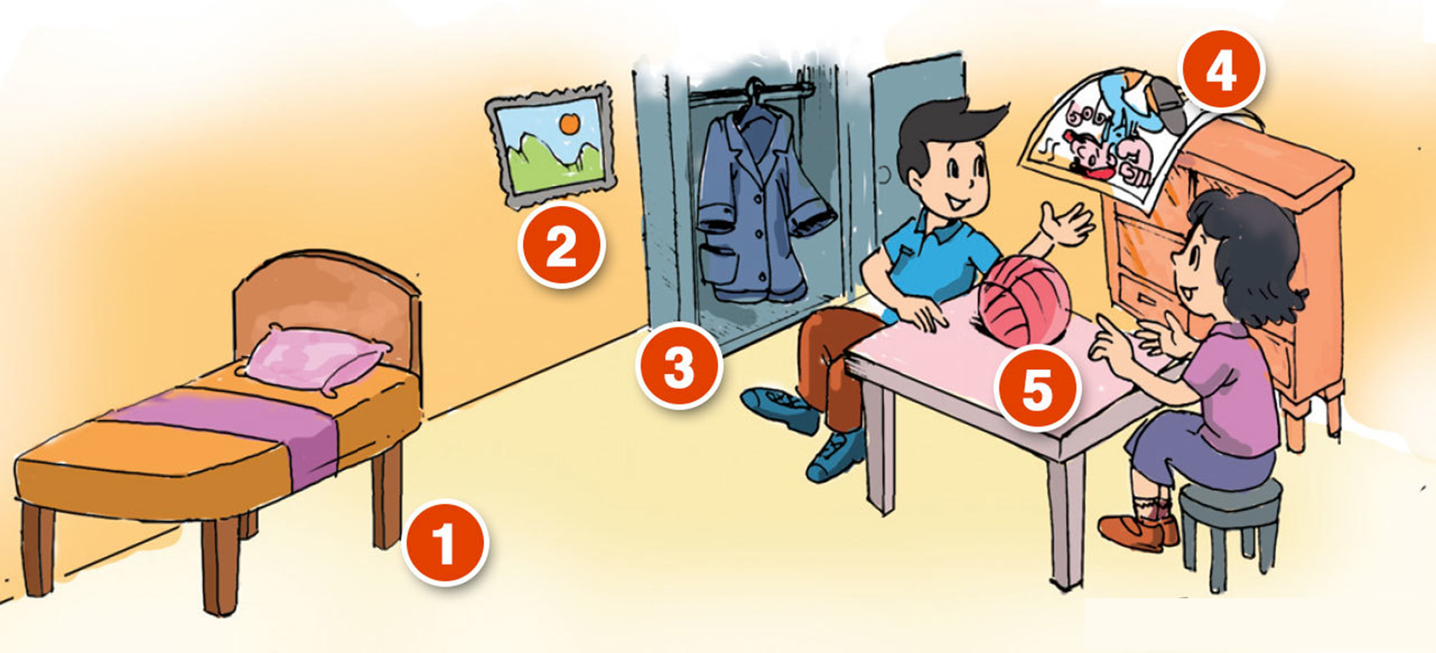
3. Let’s talk
Where's my picture?
Where's my bed?
It’s there.
It’s there.
4
Where's my ball?
2
It’s here.
3
5
1
Where's my coat?
Where's my poster?
It’s there.
It’s here.

