Slide 1
Welcome to our class
Class 5A
6/2/2022
Võ Thị Thoa

Slide 3
Thursday, February 24th, 2022
UNIT 12
DON’T RIDE YOUR BIKE TOO FAST!
LESSON 1

Slide 4
1. LOOK, LISTEN & REPEAT.

Slide 5
1. LOOK, LISTEN & REPEAT.
What are you doing, Mary?
Don’t play with the knife!
You may cut yourself.
OK
I am cutting the cabbage
What are you doing
with the stove?
Don’t touch the stove!
You may get a burn.
I want to cook
the cabbage.
OK, I won’t

Slide 6
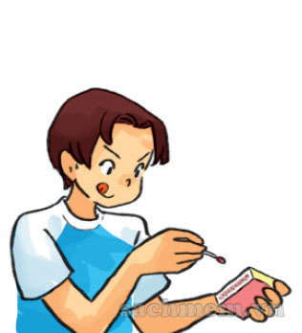
play with matches
chơi với diêm

Slide 7
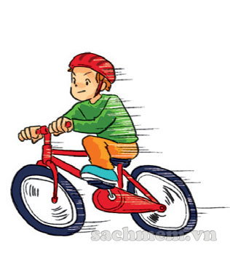
ride your bike too fast
đạp xe quá nhanh

Slide 8
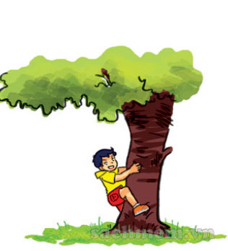
climb the tree
trèo cây

Slide 9
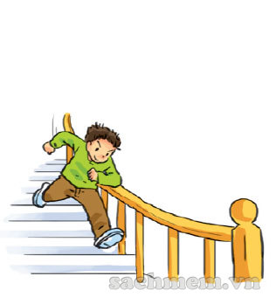
run down the stairs
chạy xuống cầu thang

Slide 10
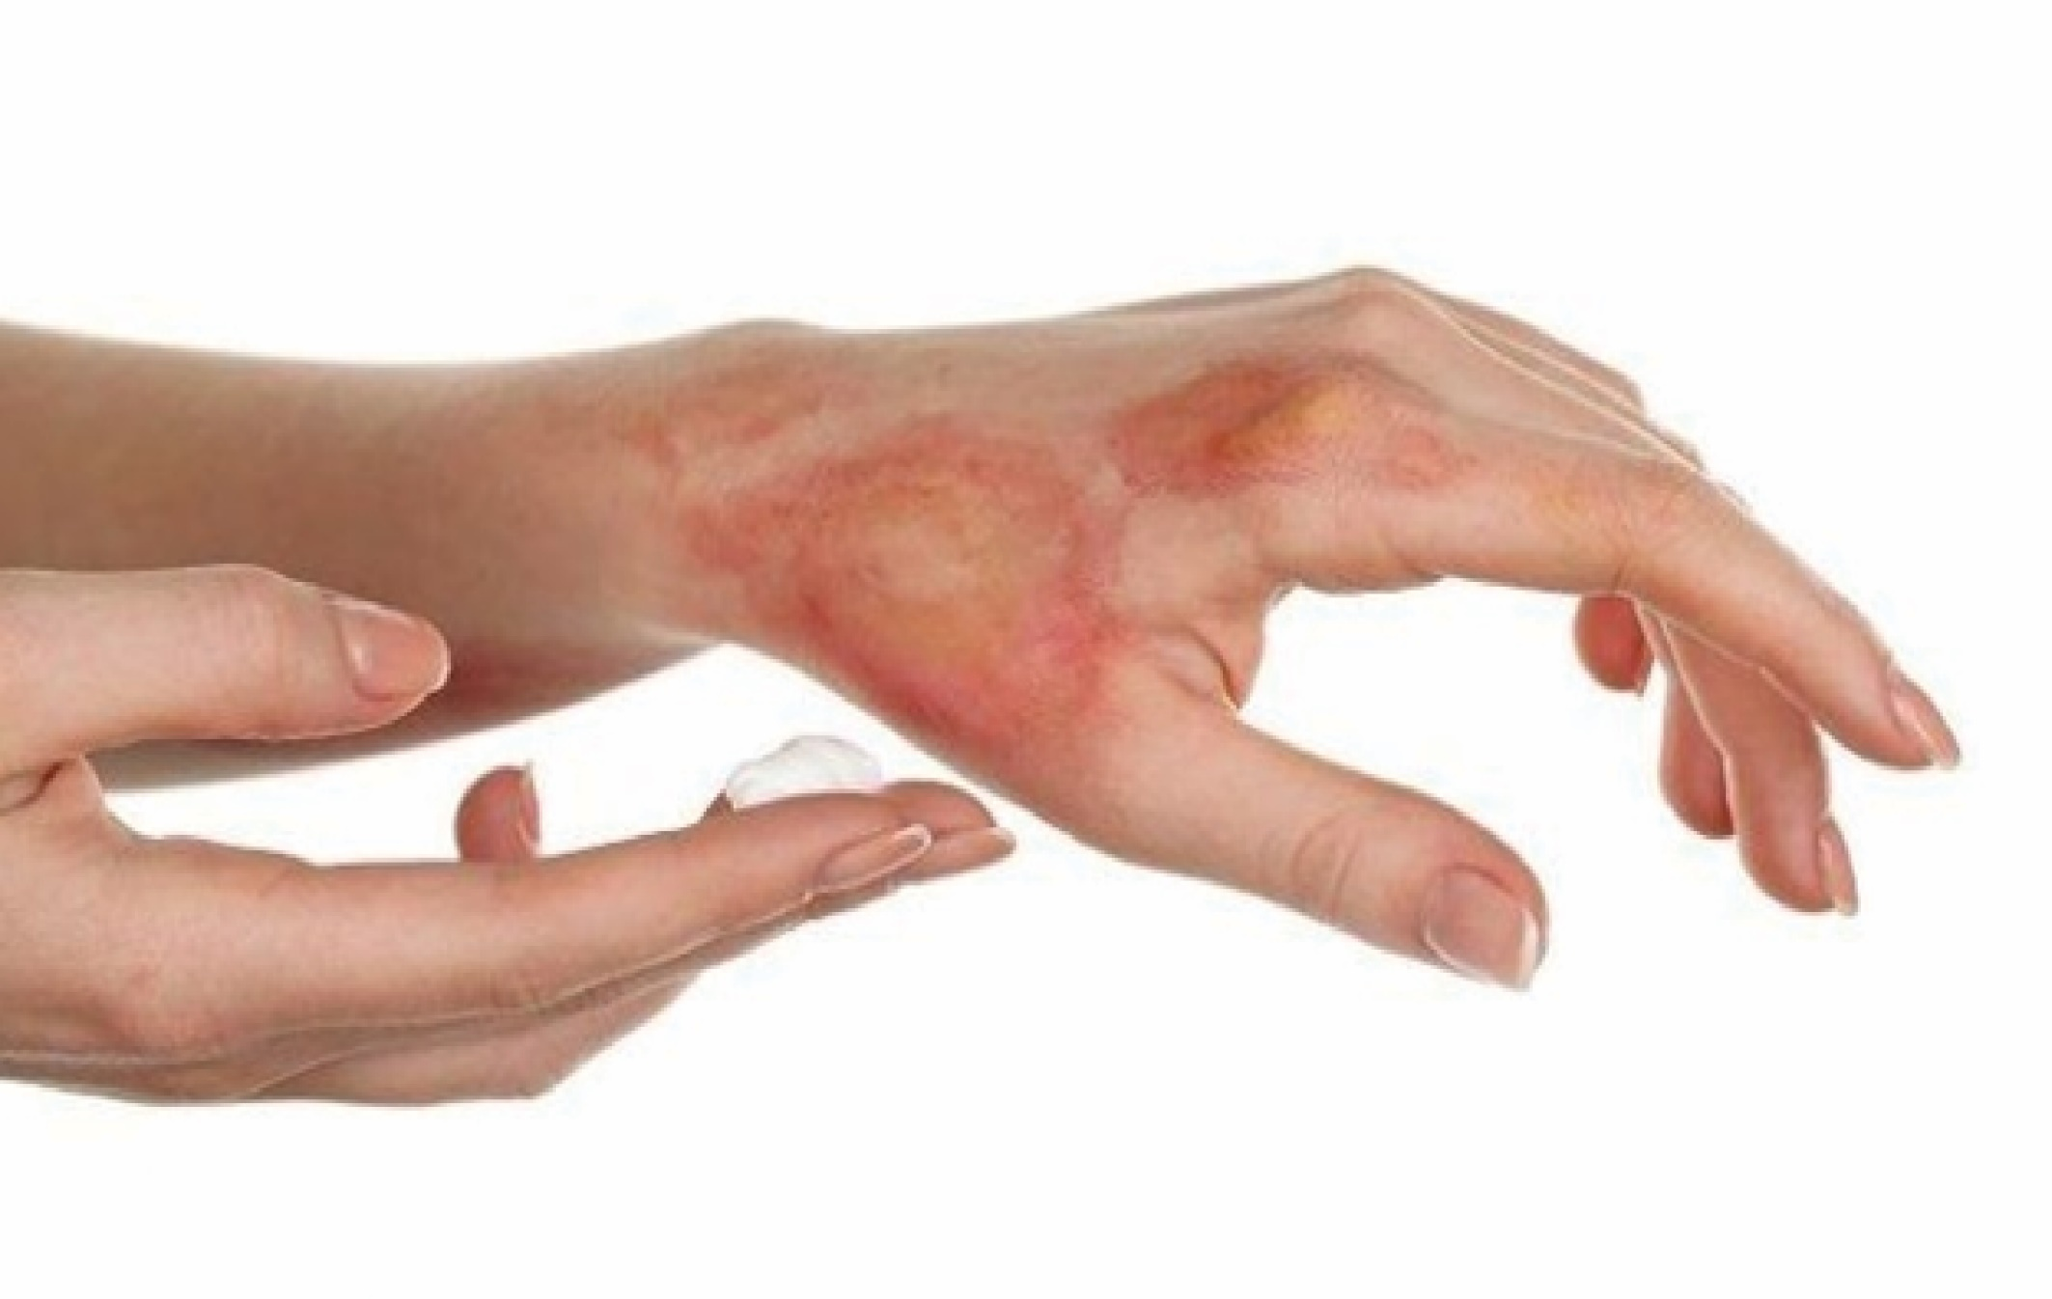
get a burn
bị bỏng

Slide 11
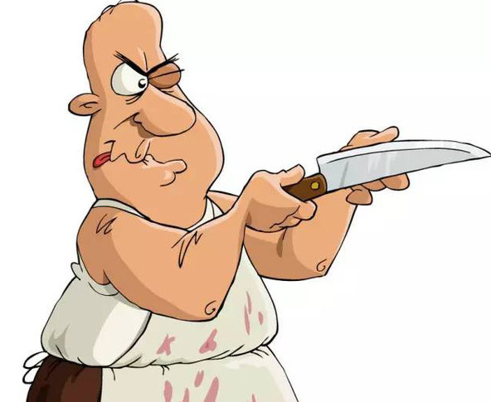
play with the knife
chơi với dao

Slide 12
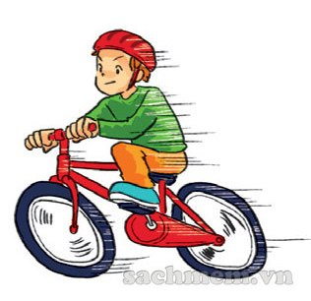
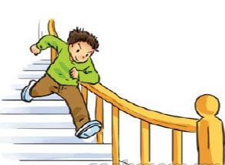
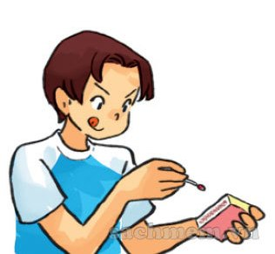
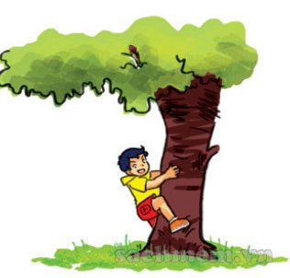
Matching
a.
1. play with matches
b.
2. climb the tree
3. ride your bike too fast
c.
4. run down the stairs
d.

Slide 13
2. POINT AND SAY.
play with matches
ride your bike too fast
climb the tree
run down the stairs

Slide 14
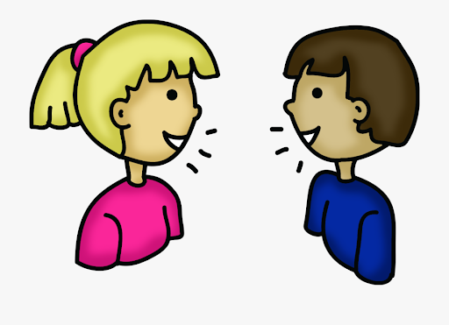
3. Let’s talk
I want to ____
What are you doing with ___?
OK, I won’t !
Don’t _____ !

Slide 15
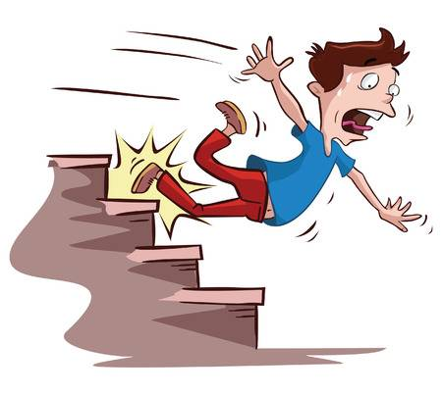
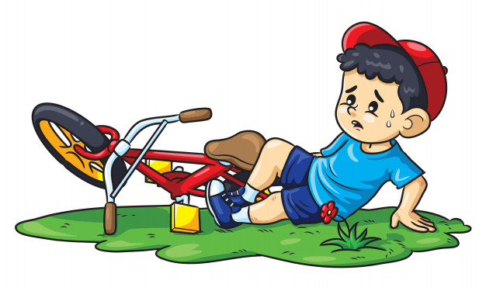
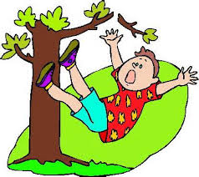
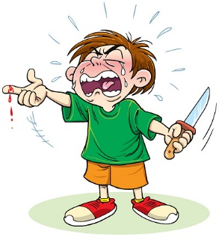
GUESSING GAME
1
2
3
4
5
6

Slide 16
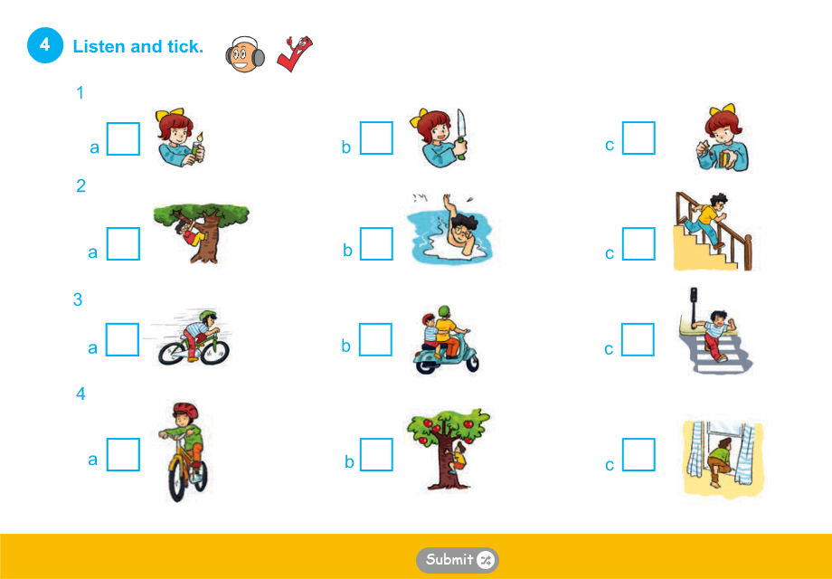
a light : bật lửa
climb a window: trèo cửa sổ

Slide 17
5. Read and complete
run answered won’t cooking room
One day, Peter was bored. He was in his (1) and his mother was (2) in the kitchen. She asked loudly “Where are you, Peter?” He (3) , “I’m upstairs, Mum.” His mother heard him running down and said “Don’t (4) down the stairs!” Peter replied “OK, I (5) do it again, Mum.”
room
cooking
answered
run
won’t

Slide 18
SUMMARY
* Dangerous activities:
Play with knife / matches. - Ride your bike too fast.
Climb the tree. - Run down the stairs.
Touch the stove.
* Give advice: Don’t ______________!

Slide 19
Thank you
and goodbye !

