Slide 1


Slide 2

Warm up
By a game

Slide 3

Game:
Look at the picture
and guess the activities

Slide 4

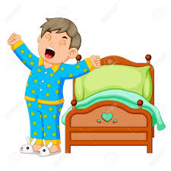
Game: Look at the picture
and guess the activities
Get up

Slide 5
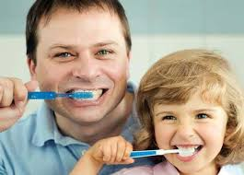
Game: Look at the picture
and guess the activities
Brush the teeth

Slide 6

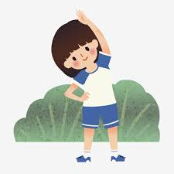
Game: Look at the picture
and guess the activities
Do morning exercise

Slide 7

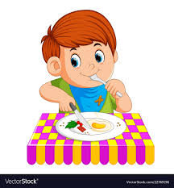
Game: Look at the picture
and guess the activities
Have breakfast

Slide 8
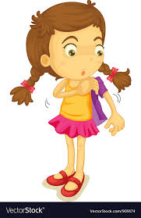
Game: Look at the picture
and guess the activities
Get dressed

Slide 9
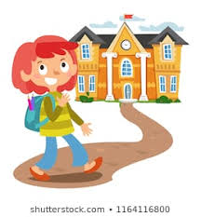
Game: Look at the picture
and guess the activities
Go to school

Slide 10
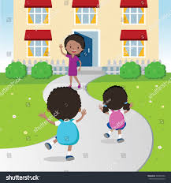
Game: Look at the picture
and guess the activities
Back home

Slide 11
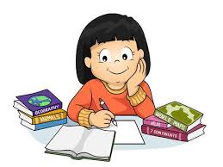
Game: Look at the picture
and guess the activities
Do homework

Slide 12

Game: Look at the picture
and guess the activity
Listen to music

Slide 13
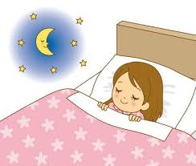
Game: Look at the picture
and guess the activities
Go to bed

Slide 14

Practise

Slide 15
Exercise 1: Choose the correct answers:
1. They usually ……… early and do morning exercise.
A. gets on B. get up C. get on D. gets up
2. What ……… you do after school? – I usually do my homework.
A. do B. are C. does D. is
3. Mary often ……… TV after dinner with her parents.
A. watch B. to watch C. watches D. watchs
4. What does your mother …….. in the evening? – She ……… me with my homework.
do – help B. do – helps C. does – helps D. does – help
5. I sometimes go to the sports centre with my friends ……… the afternoon.
A. on B. at C. with D. in

Slide 16
Exercise 2. Put the word in the correct order:
1. is/ food/ This/ we/ the/ eat/ way/ our/ . ……………………………………………………………………..
2. do/ What/ after/ she/ does/ school/ ? ……………………………………………………………………………..
3. breakfast/ have/ I/ always/ big/ a/ .……………………………………………………………………………..
4. you/ school/ Who/ with/ to/ do/ go/ ? ……………………………………………………………………………..
5. likes/ Tim/ badminton/ playing/ ……………………………………………………………………………..
This is the way we eat our food.
What does she do after school?
I always have a big breakfast.
Who do you go to school with?
Tim likes playing badminton.

Slide 17

Unit 2: I always get up early.
How about you?
Lesson 2

Slide 18


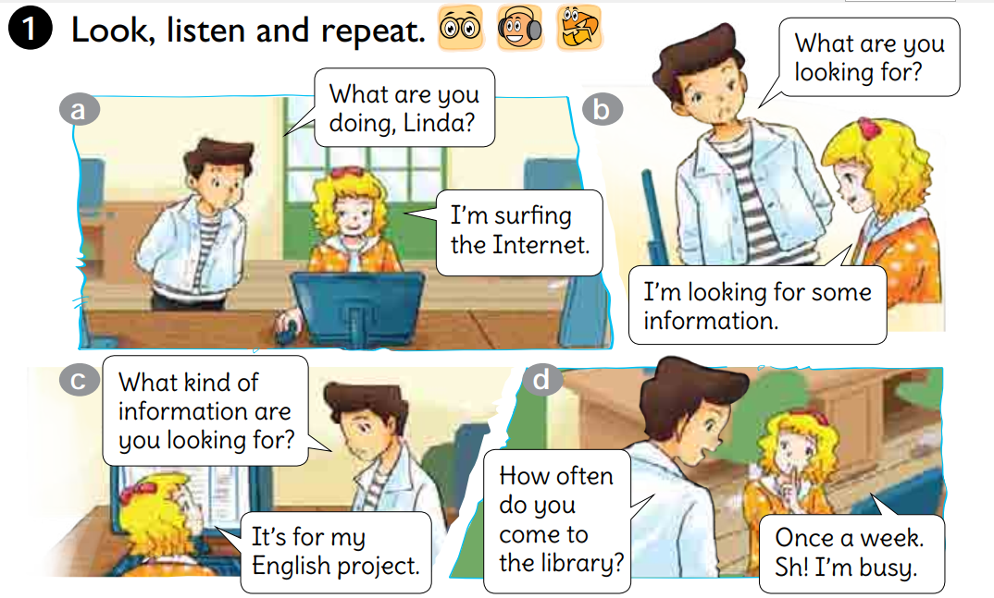

PERIOD 3rd
ABProgram

Slide 19

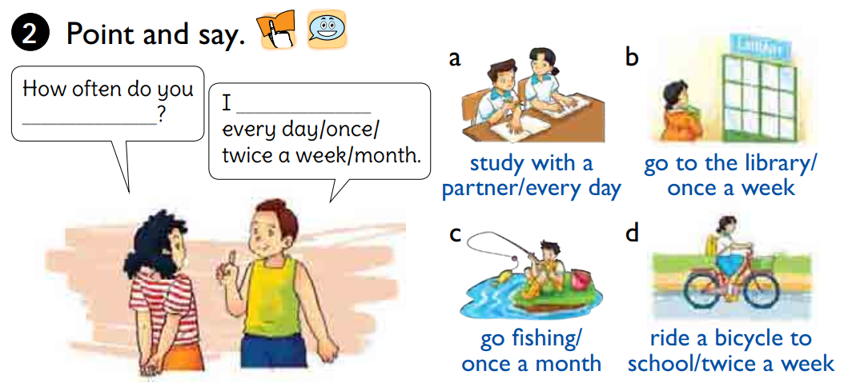
PERIOD 3rt
ABProgram

Slide 20

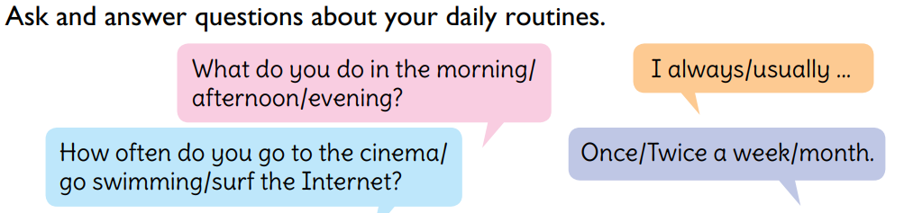
PERIOD 3rd
ABProgram

Slide 21

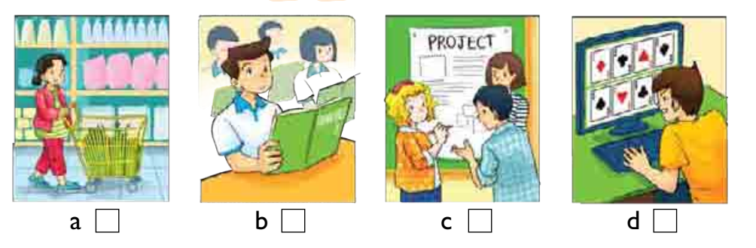
PERIOD 4th
4
1
3
2
ABProgram

Slide 22
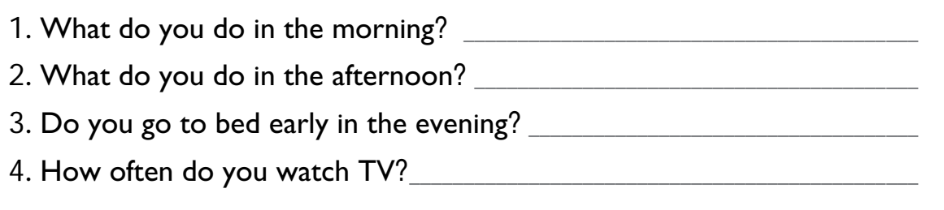
PERIOD 4th
ABProgram

Slide 23
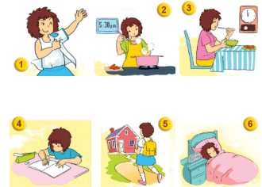
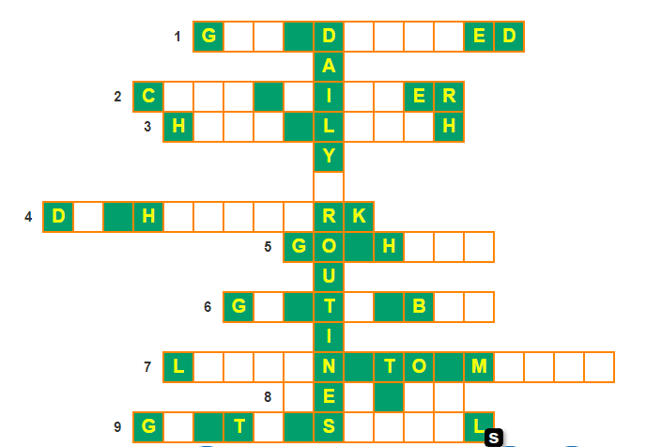
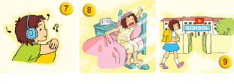
Do the crosswork puzzle
E
T
R
E
S
S
O
O
K
D
N
N
A
V
E
U
N
C
O
O
M
E
W
O
O
M
E
O
O
E
D
I
S
T
E
U
S
I
C
G
T
U
P
O
O
C
H
O
O

Slide 24


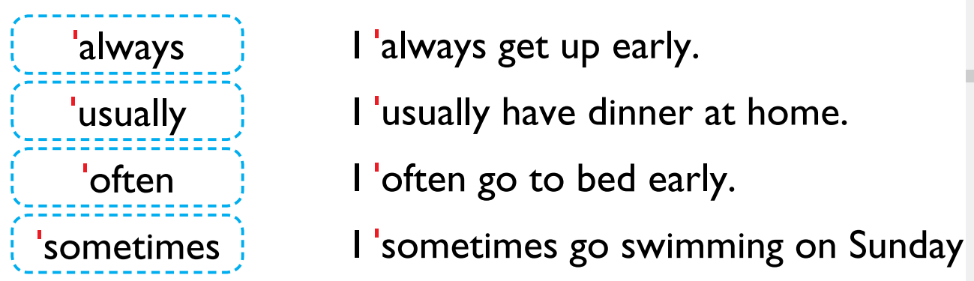
PERIOD 5th
ABProgram

Slide 25
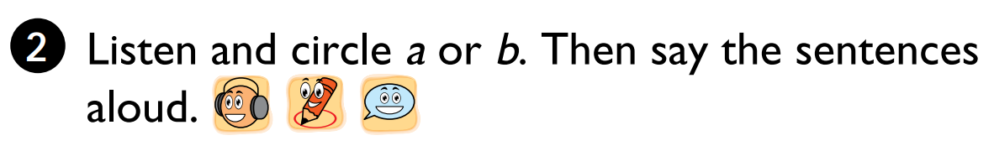
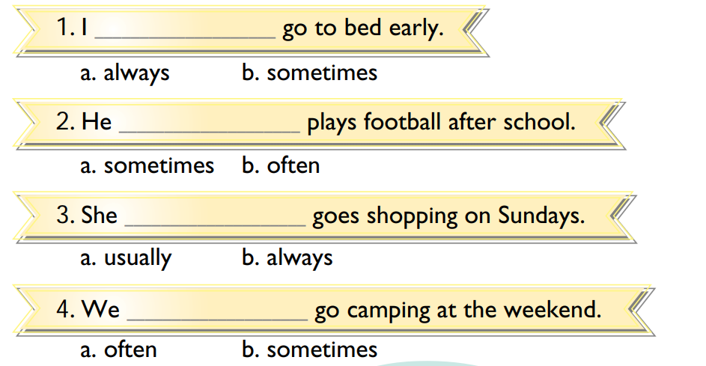
PERIOD 5th
ABProgram

Slide 26

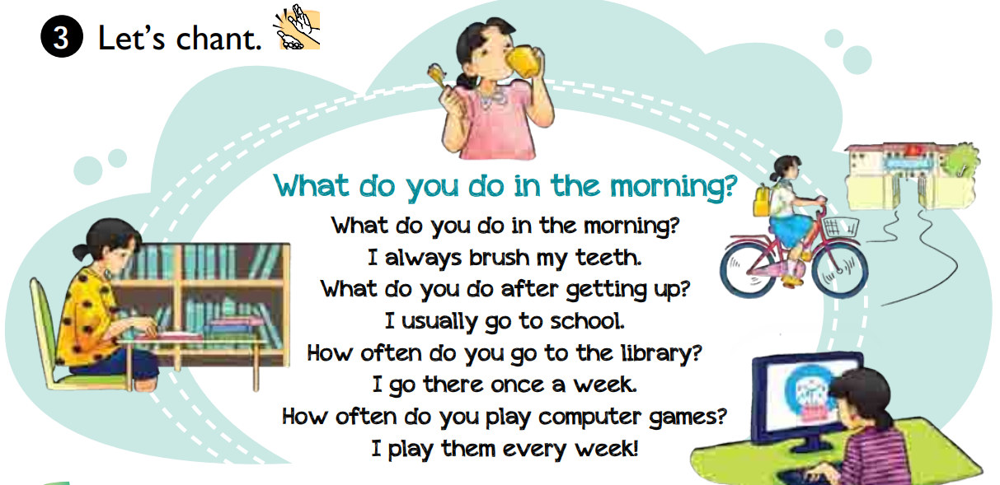
PERIOD 5th
ABProgram

Slide 27

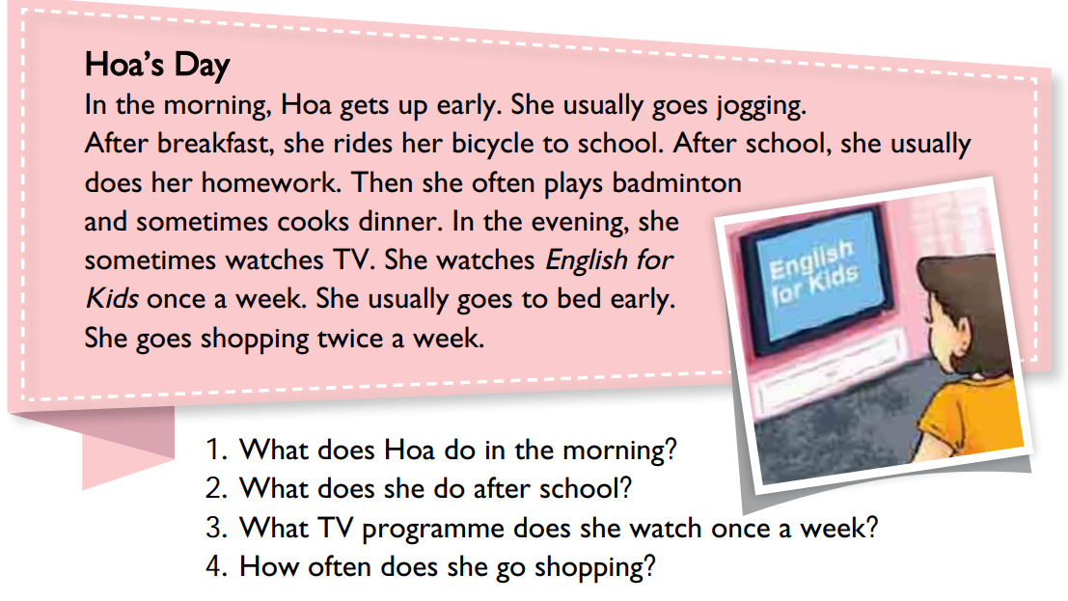
ABProgram

Slide 28

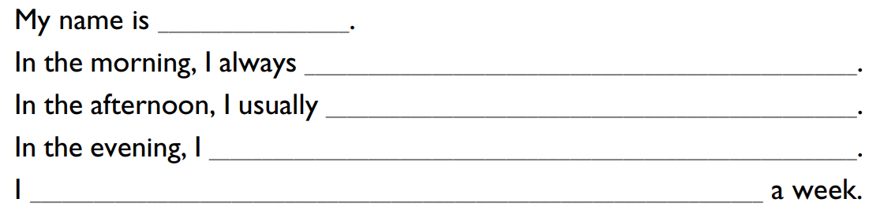
PERIOD 6th
ABProgram

Slide 29

PERIOD 6th
ABProgram

Slide 30

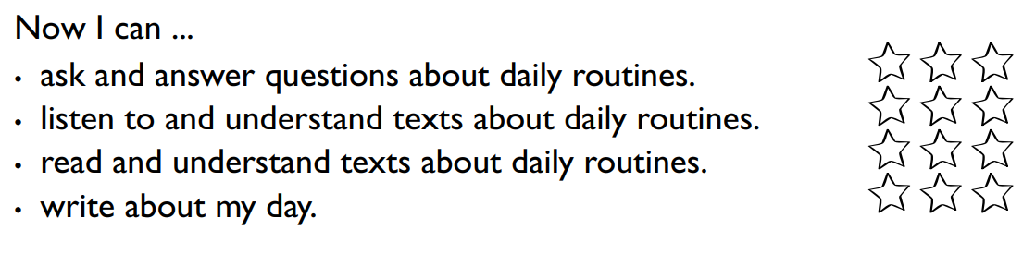
PERIOD 6th
ABProgram

Slide 31
Homework
Learn by heart the new words.
Speak with your friends
Prepare for the next..

